Slide 1
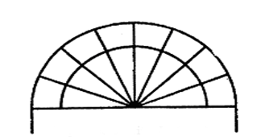
Holbrook Primary School Progression in Vocabulary linking to White Rose and the National Curriculum
September 2026

Slide 2
Holbrook Mathematics Vocabulary Progression document (YR-Y6)
This document is designed to assist with the teaching of vocabulary across EYFS, KS1 and KS2 and is aligned with the National Curriculum and White Rose schemes of learning.
This document identifies in which year group vocabulary should be explicitly taught and introduced. However, language should be revisited in subsequent year groups to ensure children are consolidating their understanding.
Some vocabulary might be introduced earlier (shapes for instance) if necessary or as part of an activity, however, this document ensures coverage is progressive.

Slide 3
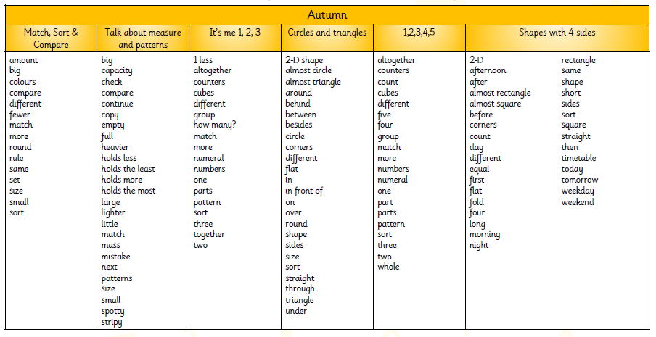
EYFS

Slide 4
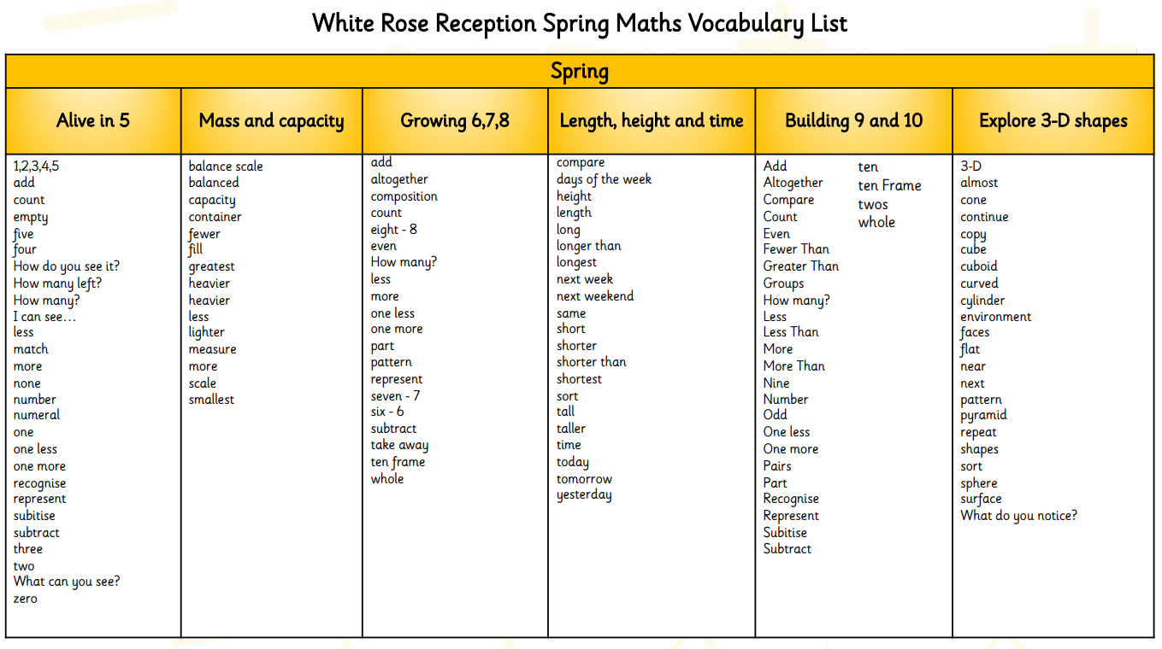
EYFS

Slide 5
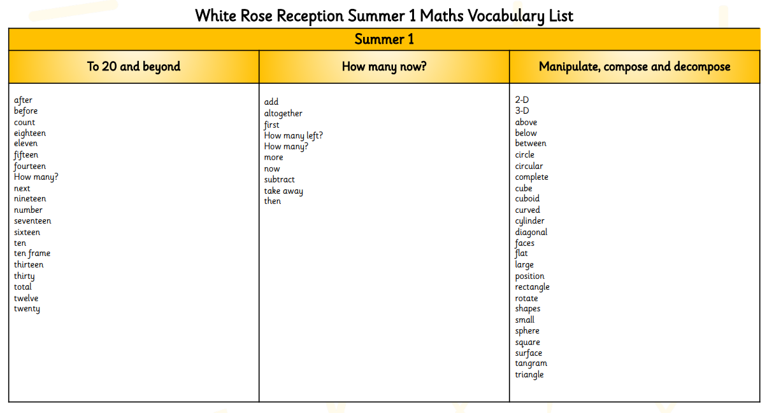
EYFS

Slide 6
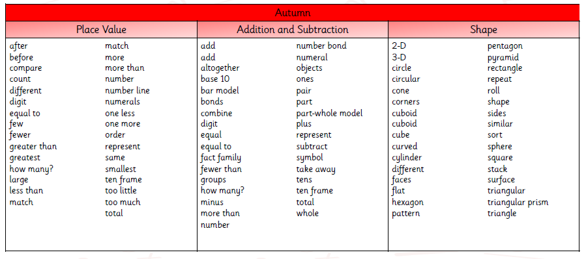
Year 1

Slide 7
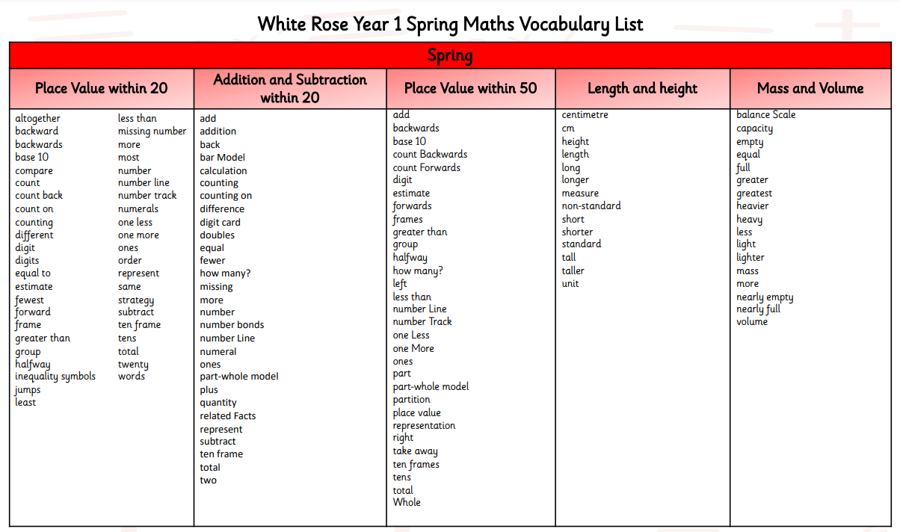
Year 1

Slide 8
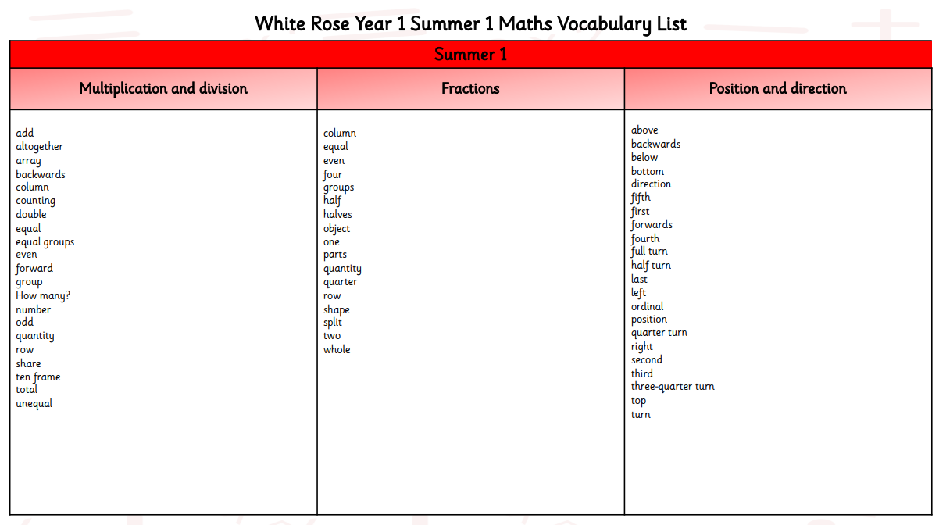
Year 1

Slide 9
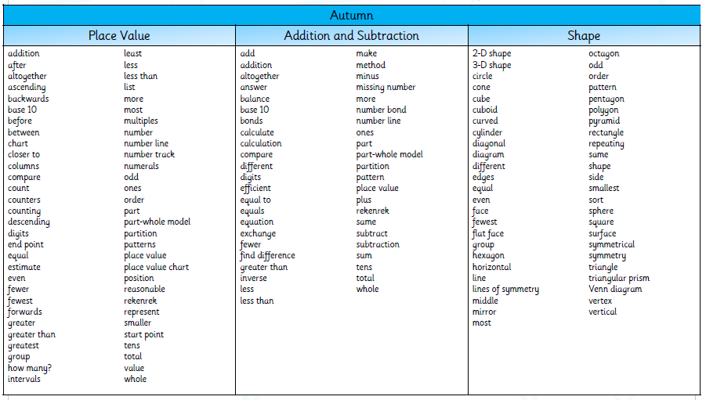
Year 2

Slide 10
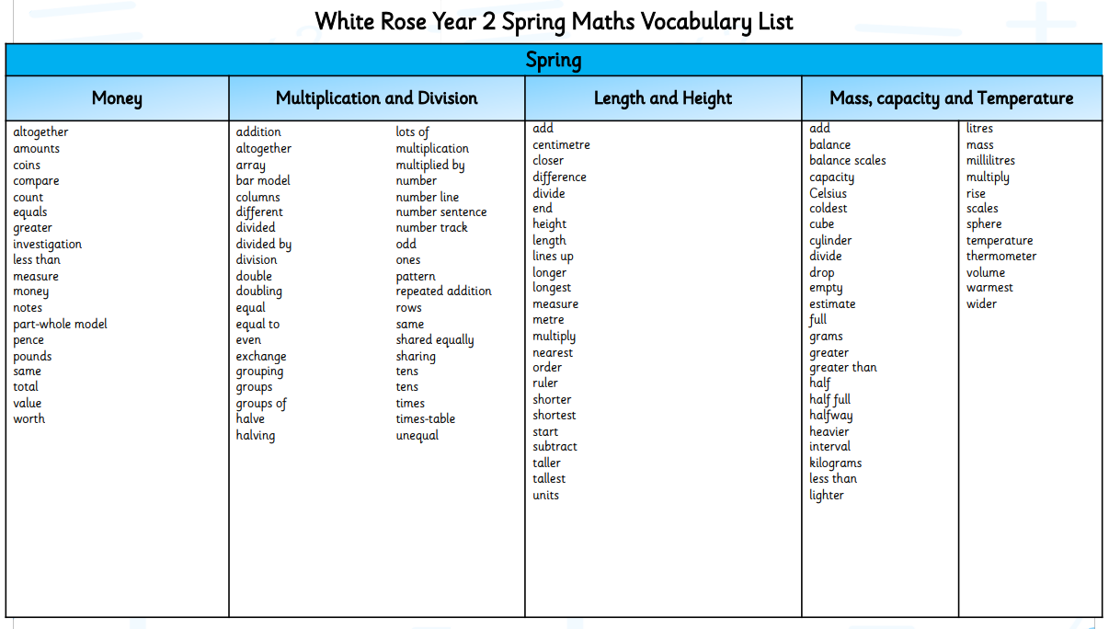
Year 2

Slide 11
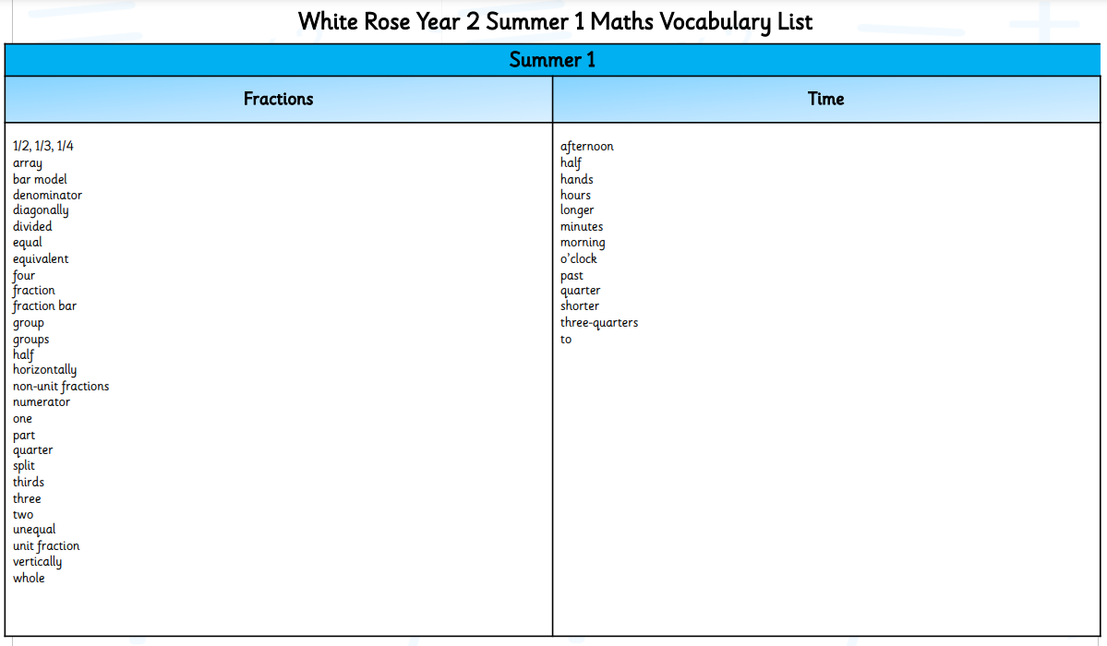
Year 2

Slide 12
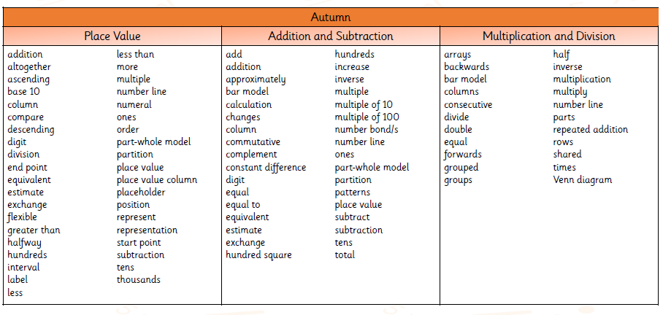
Year 3

Slide 13
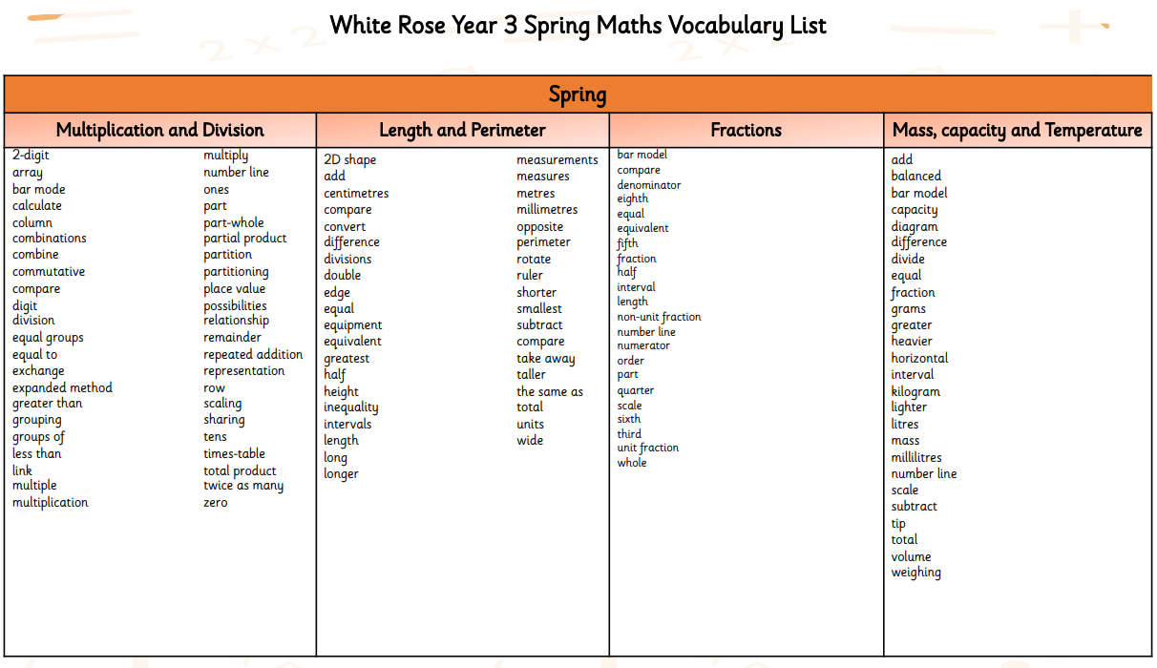
Year 3

Slide 14
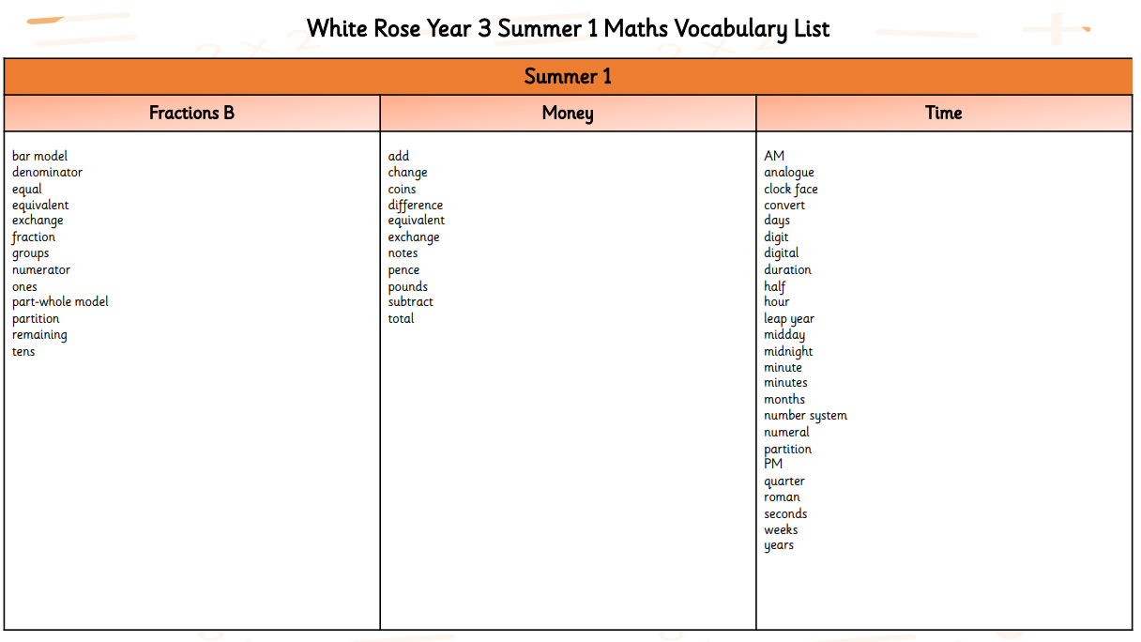
Year 3

Slide 15
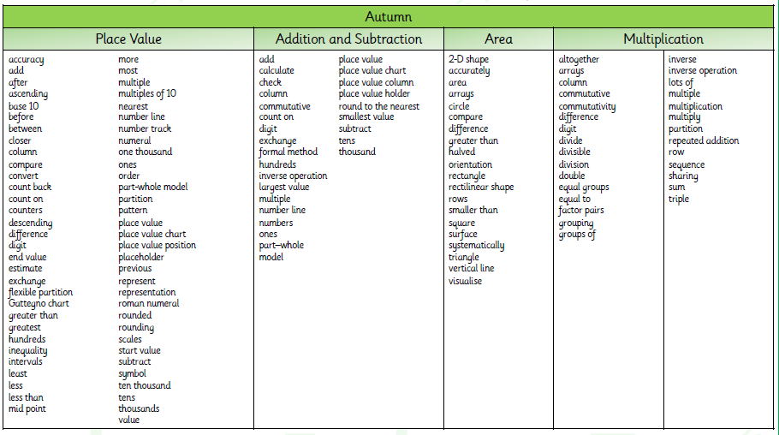
Year 4

Slide 16
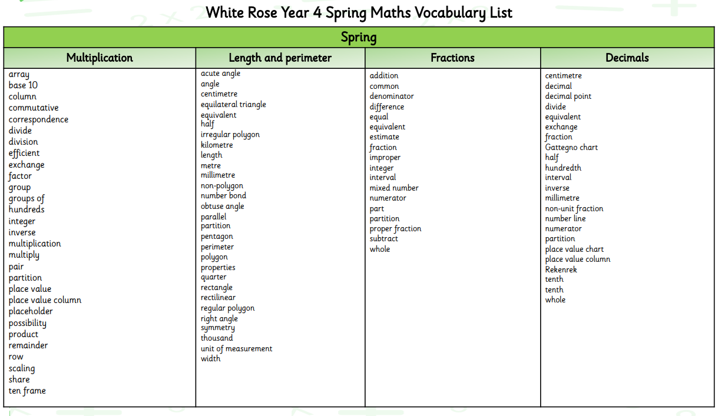
Year 4

Slide 17
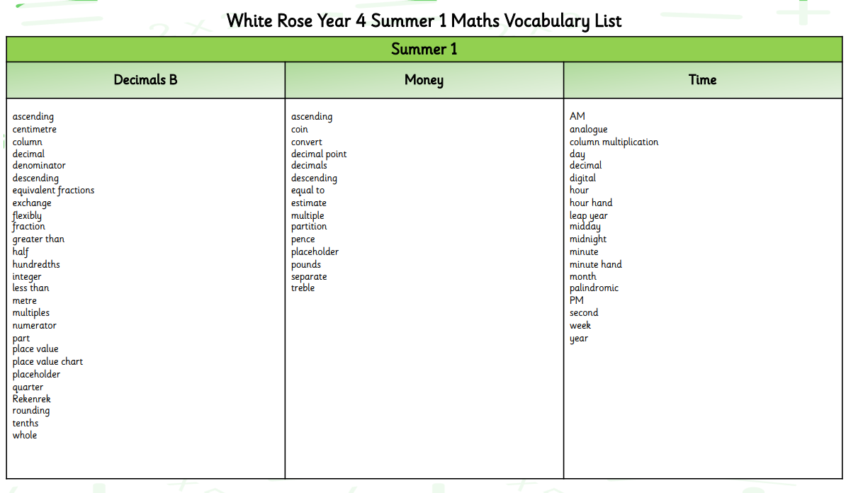
Year 4

Slide 18
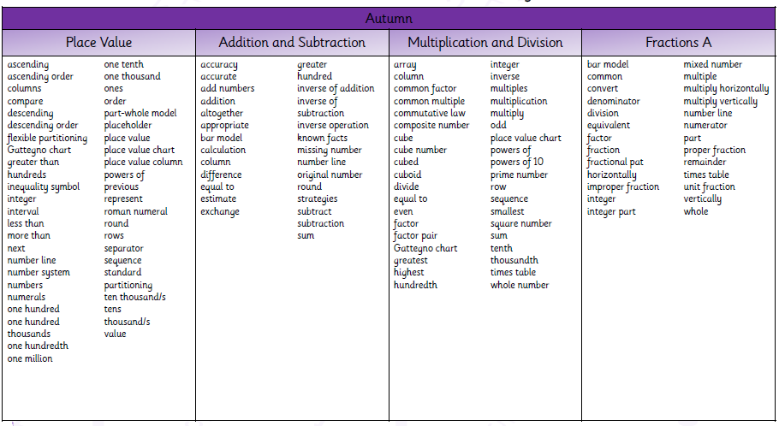
Year 5

Slide 19
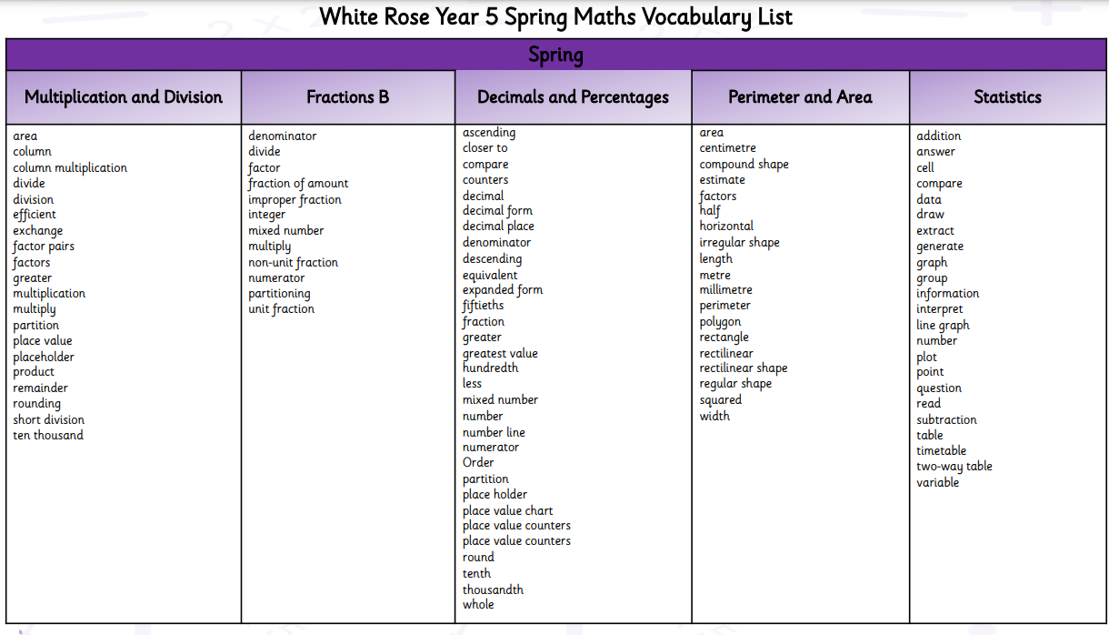
Year 5

Slide 20
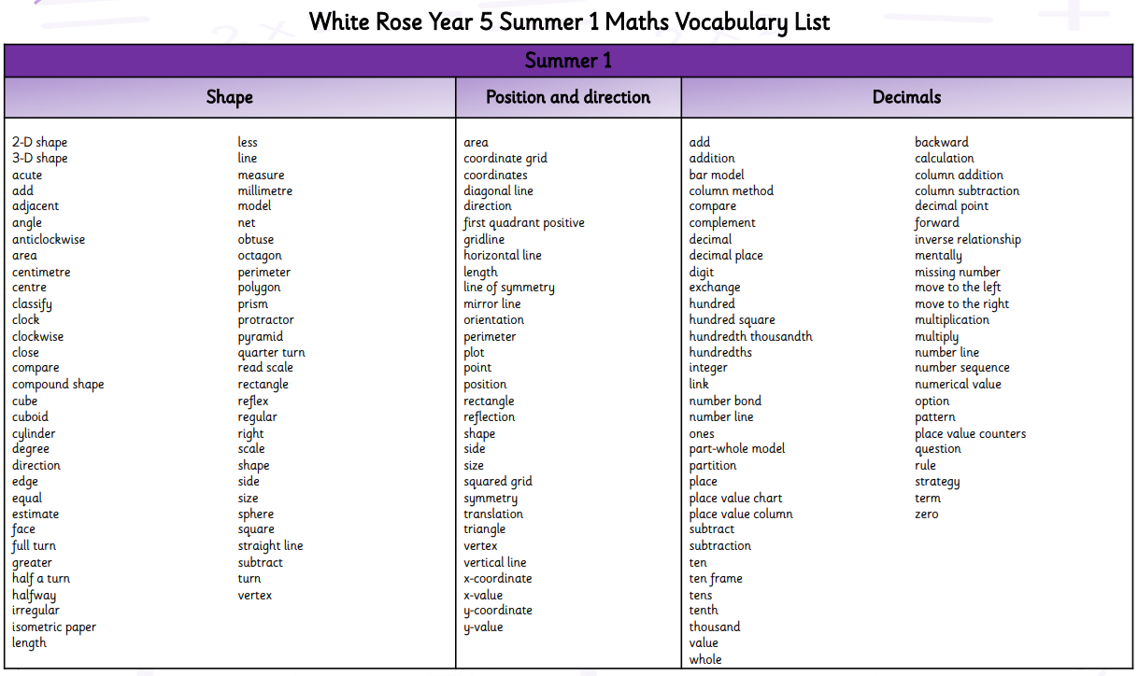
Year 5

Slide 21
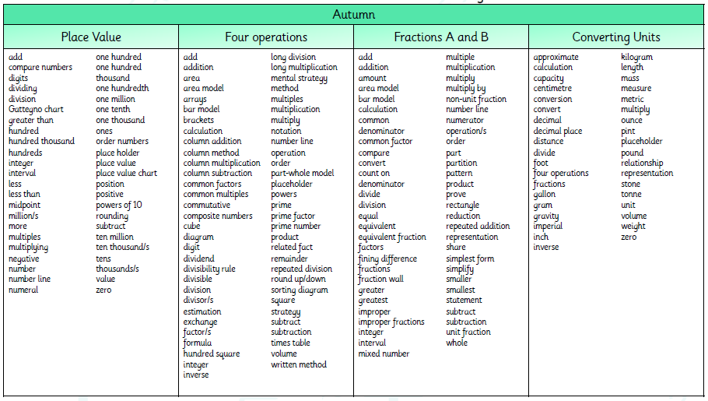
Year 6

Slide 22
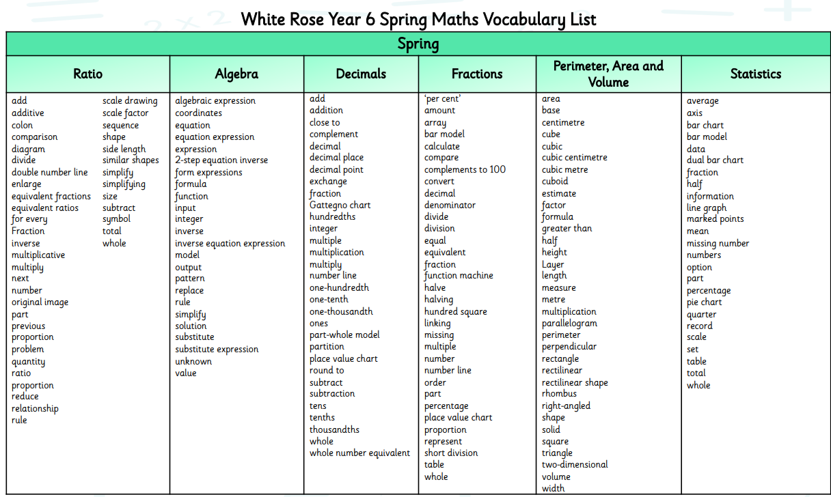
Year 6

Slide 23
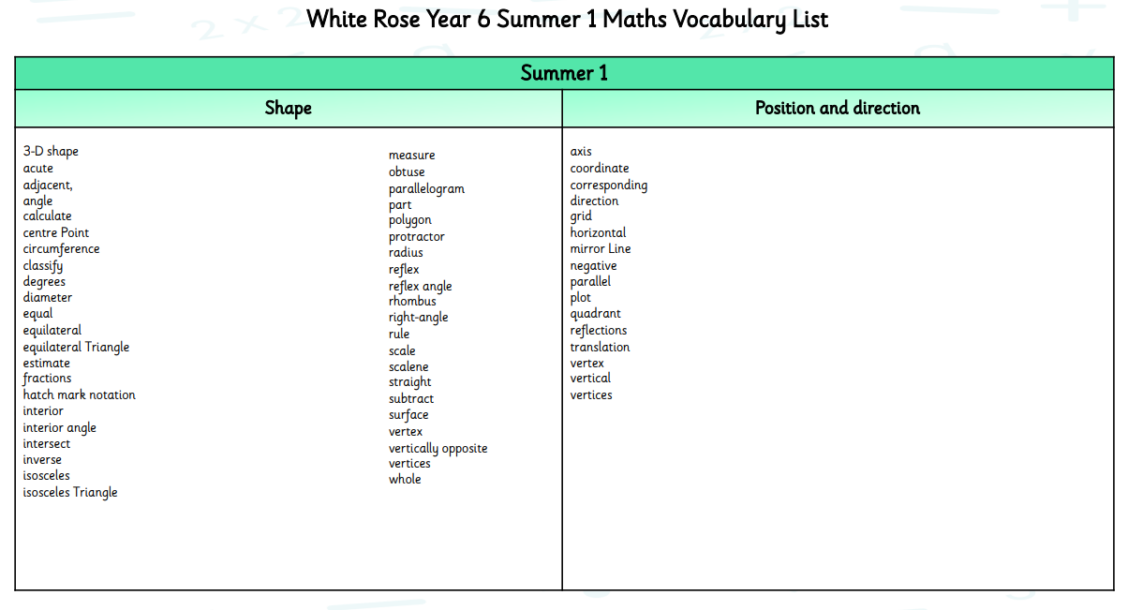
Year 6

