Slide 1


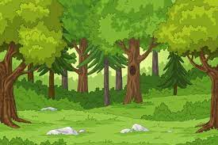

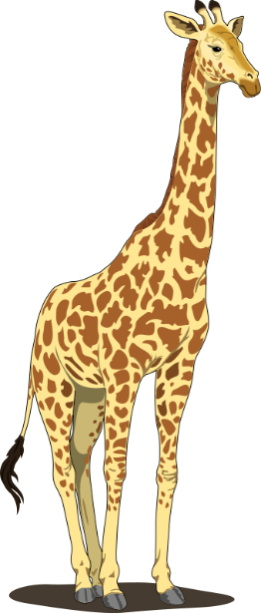


Slide 2

Introductions
staff
Teachers - Miss Swift (Foxes) and Mrs Reeves (Squirrels)
Teaching Assistants - Mrs Bullen, Mrs Brakenridge,
Miss O’Hara and Miss Nattriss

Slide 3


Topics
Autumn – Bold and Brave
Spring – Fire and Ice
Summer – Wild and Wonderful

Slide 4

Autumn
Some of the things we will be looking at…
Our school and local area
The Last Wolf
Rosie Revere Engineer
Science – habitats and materials
Geography – our local area
History – a famous person from the past (Amelia Earhart)

Slide 5
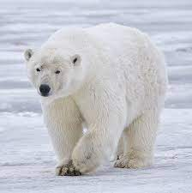
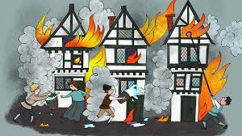
spring
Some of the things we will be looking at…
Geography – Polar Regions
Polar animals research
The Arctic Song
History – The Great Fire of London
DT – fire engines
Masha and the Firebird

Slide 6

summer
Some of the things we will be looking at…
Geography – Africa and Kenya
The Hunter
James and the Giant Peach
African animals research
Minibeast poems
DT – sewing African animals
Science – plants, animals and humans
More details of each term will be provided at the start of each term. A yearly overview is available on the school website.
Notes:
New RE?

Slide 7
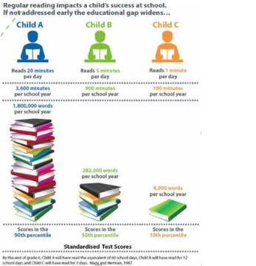
Reading
We encourage parents and children to record reading experiences regularly in their reading diaries (Home Learning policy = daily reading until colour bands are finished, then 4x a week afterwards.) We also enjoy hearing the children read at home on Tapestry.
We collect up the reading diaries on a Friday so please ensure they are in school.

Slide 8
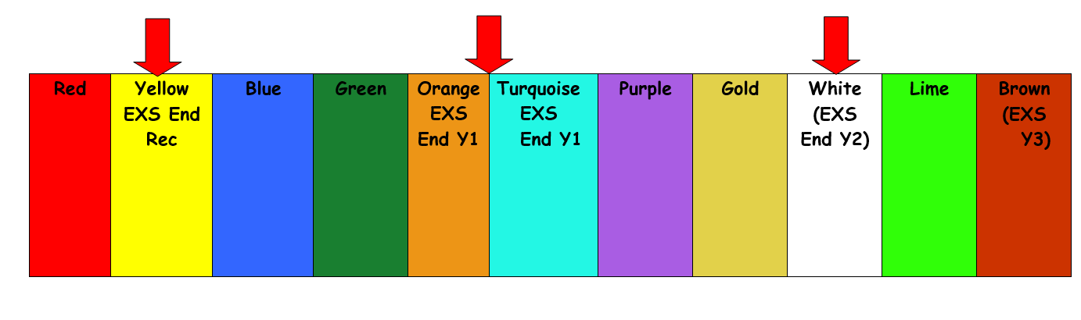
Reading
In school, children will experience reading in a variety of contexts, for example as a whole class, group or individually with a teacher/TA/parent helper.
Some children will be bringing home phonic reader books matched to the letter sounds they know, as they did in Year 1. Please ensure the children have their reading books in school every day in case we want to read with them. They may also bring home a book to share with an adult.
Phonic Reader books merge into green colour band books, and children on these levels are encouraged to take responsibility for changing their books once they have read them at home. We issue regular reminders, but the ultimate responsibility is with them.

Slide 9
tapestry
We will be using Tapestry as an online learning platform this year.
We will upload home learning to Tapestry on Fridays and it is due on the following Thursday.
We will send other useful information via Tapestry.
Please use class emails for messages.
foxes@holbrookprimaryschool.com
squirrels@holbrookprimaryschool.com

Slide 10
A home learning task will be one of these things we have covered during the week. We will vary the task so it might be a maths focus or spelling activity for example. We are happy with anything and in fact enjoy seeing your creativity!
Reading and mental maths is an ongoing home learning task and should be done regularly.
We have begun our Karate Spellings (these are the ’tricky word’ spellings that children are expected to know in YR, Year 1 and Year 2 as set out in the National Curriculum).
Home learning

Slide 11
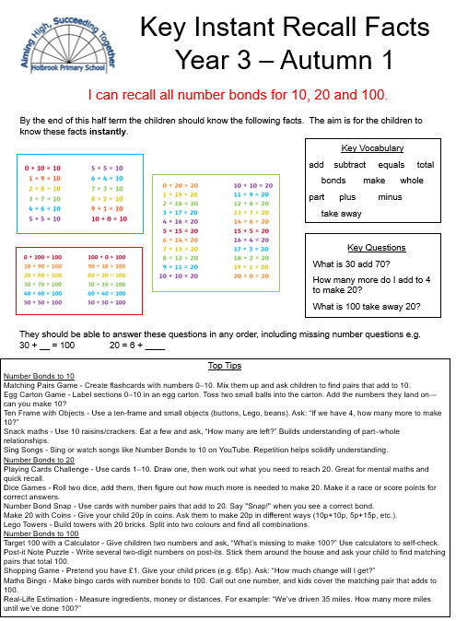
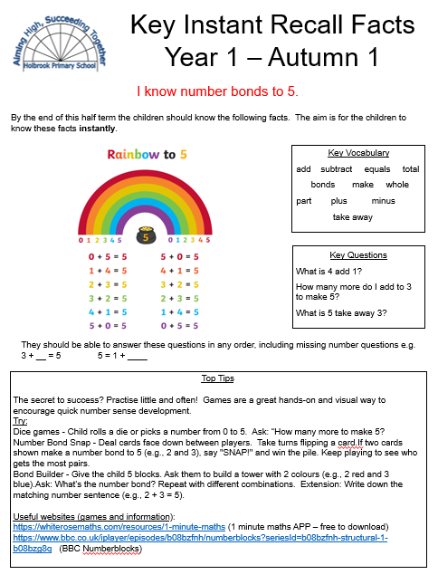
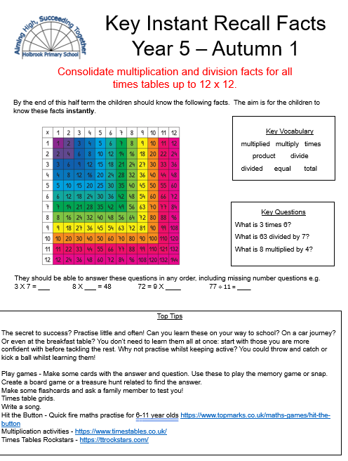
Key Instant Recall Facts (KIRF’s)
KIRFs are sets of key mathematical facts that children need to know off by heart so they can recall them quickly and accurately. These facts play an important role in helping children become more confident and efficient when working with addition, subtraction, multiplication and division.
Each half term, your child will be given a new KIRF sheet.
To get the most benefit, they should be practised frequently in short bursts rather than in long sessions.

Slide 12
Reading:
Song of Sounds tricky words
Regular reading, including reading to the children
Maths:
Counting
Number bonds to 10 and 20
Telling the time
Spelling:
Tricky words (Karate spellings) and Year 2 spelling patterns and rules
General:
Praise effort
Encourage independence and a growth mindset
How you can help

Slide 13

Extra-Curricular
Autumn term – Y1 and Y2 Nativity
Spring Term – Fire Engine visit
Summer Term – Drusillas Trip
Other things may arise during the year.

Slide 14
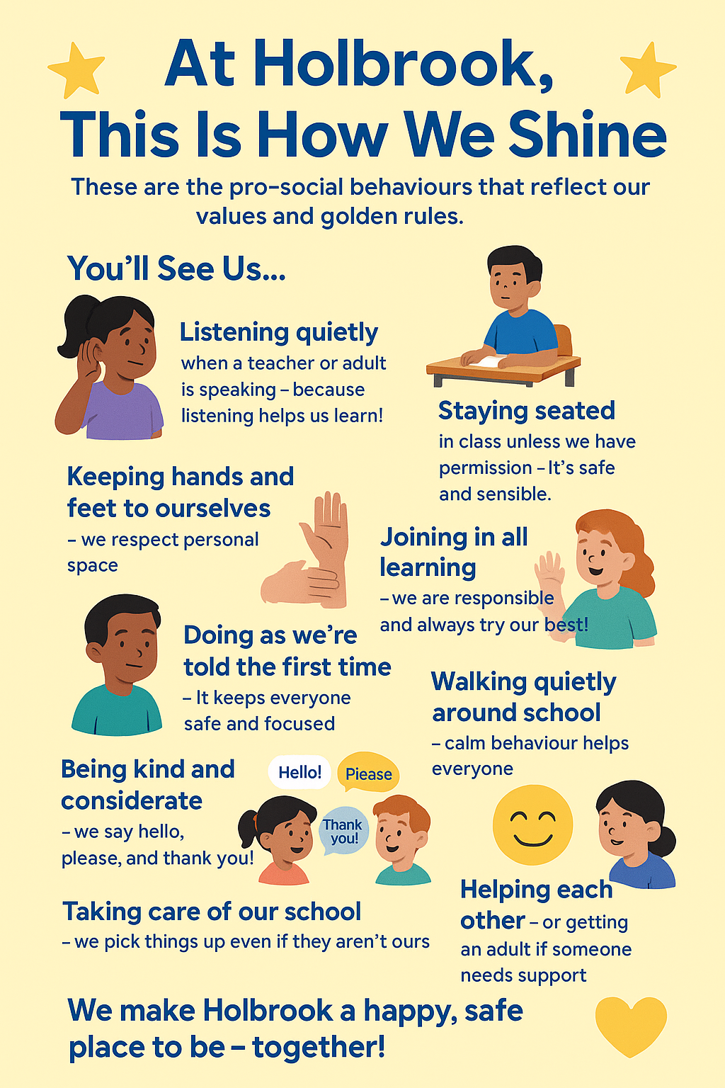
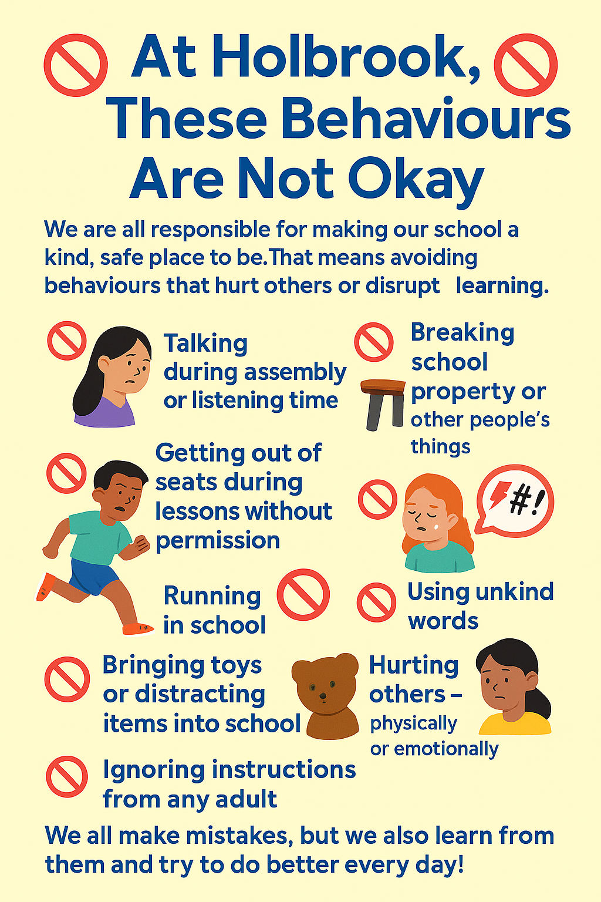
Expectations for Holbrook Children

Slide 15
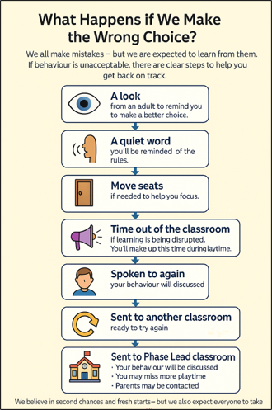

Slide 16


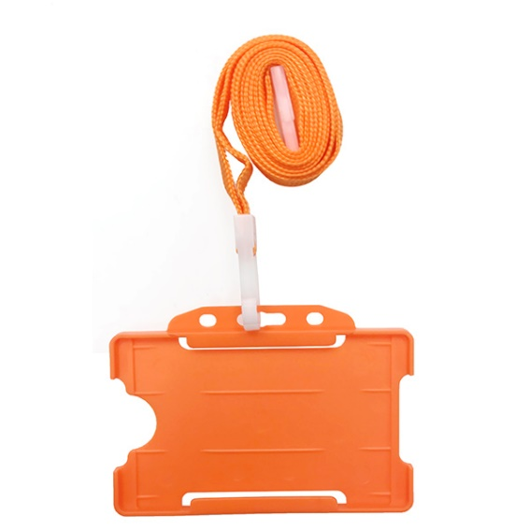
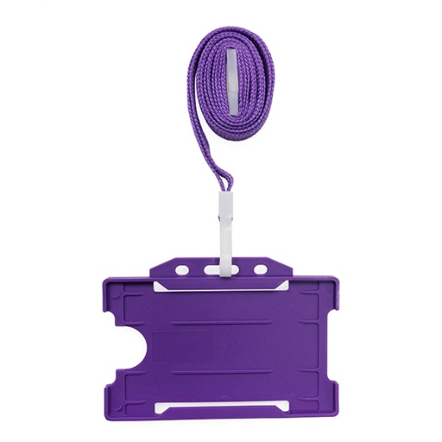
Learning Skills
Gold Award
House Points
House Star
Maths Mentor
Writing Mentor

Slide 17
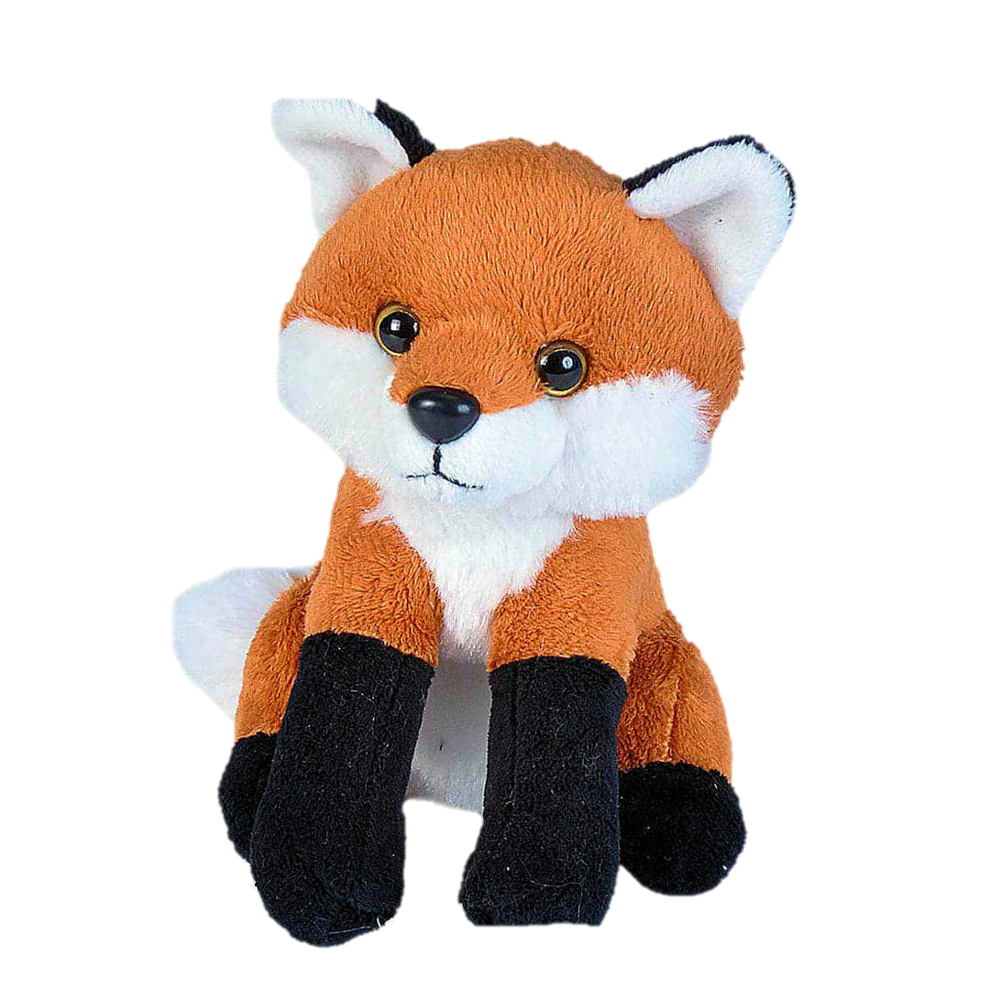
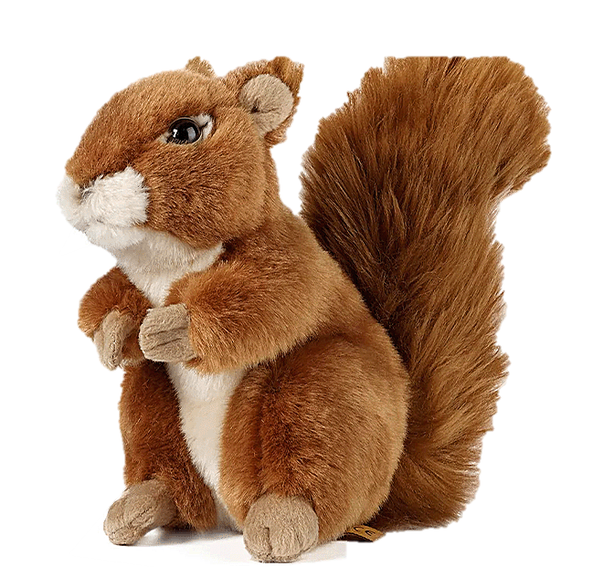
Fox and Squirrel Adventures!

Slide 18
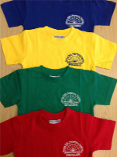

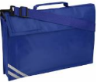

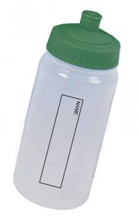
Other Information
PE – Tuesday and Wednesday
Please remember to take earrings out for PE days or cover them in tape
The children can wear their kit to school on these days. The children should wear plain black shorts/joggers and their house t-shirts. They should wear their usual royal blue Holbrook School jumper/cardigan/fleece
We go out to play and PE in all weathers so please ensure they have warm/waterproof coats for cold and wet weather and hats for hot weather
Water bottles in school
Book bags – that fits into tray
Hair tied up with school colour hair ties
Laces – no laced shoes unless they can tie them themselves.
Reading morning - Fridays

Slide 19
Useful contacts
Class emails:
Foxes: foxes@holbrookprimaryschool.com
Squirrels: squirrels@holbrookprimaryschool.com
X:
@PrimaryHolbrook
Facebook:
Holbrook Primary School
Website:
Holbrook Primary School

