Slide 1

Welcome to
Year 1

Slide 2
Meet the Team
The Teachers
Mrs A Boulton, Mrs C Kerr
The Teaching Assistants
Mrs Marklew, Mrs Murdock and Miss Sinfield
LSAs
Miss O’Reilly, Mrs Woodward, Mrs Moszkal
Cover Teachers for PPA
Mrs Duo, Mrs Thompson
Notes:
JW

Slide 3
Autumn Term
Dragons and Drawbridges
English – Drawing Club
Stories -The Egg
The Kiss that Missed
Non-fiction – Castles
Maths – Place Value
Art – Picasso Portraits, Dragons
Geography - Local area
History- Castles
RE – The Creation Story
Science – Materials and their properties
DT- Mechanisms (Sliders and Levers)
ICT - Programming – moving a robot
Music- Musical Vocabulary/Pulse and Rhythm
PHSE- Friendship and Bullying
Notes:
EB

Slide 4
Spring Term
Let’s Grow
English – Curious Quest
Fairy Tales –The Enormous Turnip, Jack and the Beanstalk
Poetry – ‘Out and About’ by Shirley Hughes
Maths – Addition and Subtraction
DT/PE - Healthy living
History – Florence Nightingale/Mary Seacole
Science - Ourselves, animals and humans
Geography – Weather in UK
RE – What is God’s job? Why should we care for the world?
Art- Orla Kiely / Lucy Rei
ICT- Technology around us
Music - Dynamics and Tempo Timbre and rhythmic patterns
PHSE – Celebrating me, you and our families/ Safety at home
Notes:
CF

Slide 5
Summer Term
Oh, What a Wonderful World!
English- Curious Quest
Stories – The Snail and the Whale
Katie in London
Maths- factions, multiplication and division
Geography – What is it like to live by the coast?
History/DT – Seaside holidays in the past / Piers
Science – Seasonal changes, plants
RE- How do we know new babies are special? Why should we care for others?
Art-Zaria Forman and Bridget Riley / Kurt Jackson
ICT - Digital Writing /Grouping Data
Music-Pitch and tempo / Vocal and body sounds
PSHE- Being healthy/Showing kindness to ourselves and others
Notes:
JW

Slide 6


Expectations for Holbrook Children

Slide 7
Year Group Expectations
Developing independence in all areas
Whole class inputs for teaching
Building up independent work as the children are ready
Challenge time
Encouragement at home – home learning
Importance of grasping basic skills in maths and English
Growth Mind-set
Notes:
EB

Slide 8

Learning Skills
Notes:
JW

Slide 9
Tapestry & Home learning
We will set Home Learning every Friday on Tapestry.
Due in the following Thursday
Reading, Phonics/spelling and Maths to support work in class
Teachers will ‘like’ or comment (not all work will be commented on, but we do look at all uploads!)
Tapestry is a useful way of contacting the teachers, but is not always checked until Home Learning is due in, so please use class emails for urgent messages etc.
We will also upload useful resources and web links to Tapestry, so keep checking in regularly please.
Notes:
JW

Slide 10
How parents can help
Encourage your child to be curious, to experiment, to use their imagination and to be messy.
Praise their hard work rather than the marks they get.
Make it clear that being hard-working and intellectually curious is cool.
Praise them when they think for themselves, work well in teams and change their minds after thinking something through.
Accept that failure is a really important part of learning.
Encourage them to do activities such as writing, reading, watching fiction and solving puzzles.
Notes:
CF

Slide 11


Slide 12
Reading Diaries
Diaries are for your child to share the range of texts they are reading at home with their teachers.​
Please can children/parents/carers record their reading by writing the date and title. ​
You or your child may wish to write a comment about your reading. ​
We would encourage you to read daily. This could include texts your child has read themselves as well as texts you have shared together. i.e. bedtime stories.​
Please ensure the diary is in school every day. ​

Slide 13
Reading Diaries
The teachers will check the diaries regularly, but this diary is for you/your child to write in.
The diary will move with your child through the school so please look after it! Replacements will need to be paid for through the office. ​
You will also receive year group specific guidance i.e. suggested parental comments (KS1) , links to suggested books, KS2 genre/coverage sheet, question prompts ​
Book changing – children to put diary and phonic reader in book changing box, at least once a week, when they are ready to change it.

Slide 14
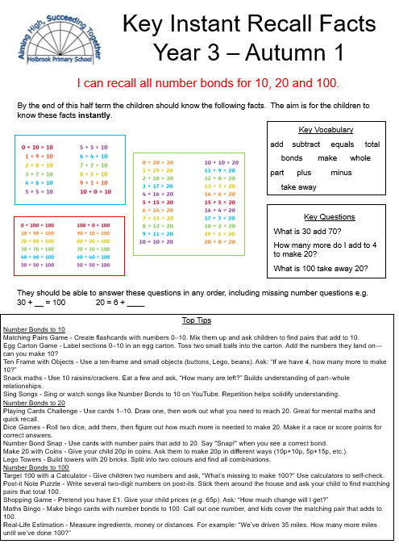
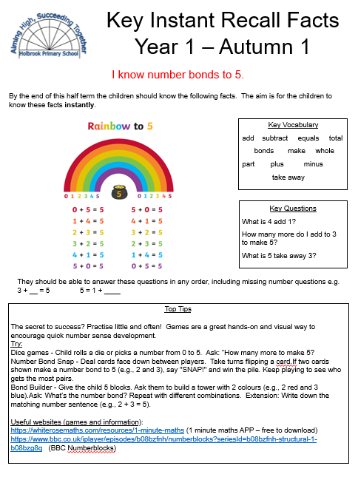
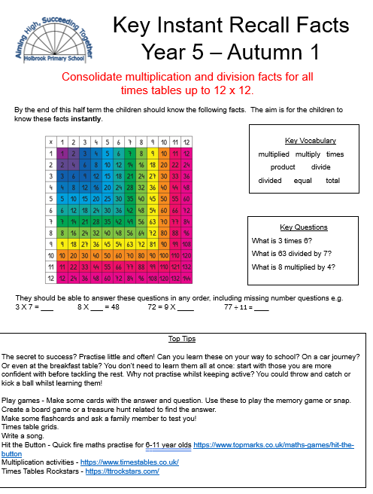
Key Instant Recall Facts (KIRF’s)
KIRFs are sets of key mathematical facts that children need to know off by heart so they can recall them quickly and accurately. These facts play an important role in helping children become more confident and efficient when working with addition, subtraction, multiplication and division.
Each half term, your child will be given a new KIRF sheet.
To get the most benefit, they should be practised frequently in short bursts rather than in long sessions.

Slide 15
Reminders
Snacks – piece of fruit or vegetable only. Fruit provided at break time. Milk during morning session.
Uniform – named!
Please start bringing coats
Water bottles – water only for classroom bottle
Will need second drink for packed lunches
Notes:
CF

Slide 16
Reminders
Book bags – no rucksacks or large key rings please due to space constraints.
PE is on Mondays and Fridays. Children to wear kit to school. Please check they are wearing correct PE Uniform. No earrings – or provide tape please.
No toys to be brought into school
Animal adventures – Hop/Stripe will go home on a Friday and needs to be back on the Monday please. We will share photographs from Tapestry the following week.
After school arrangements – please tell whoever is on the door in the morning – we are currently compiling a list so do let us know if anyone regularly collects your child other than yourself/partner.
Notes:
CF

Slide 17




@PrimaryHolbrook
Holbrook Primary School – Horsham
https://www.holbrookschool.co.uk/
badgers@holbrookprimaryschool.com
rabbits@holbrookprimaryschool.com
Notes:
EB

Slide 18
Please feel free to come and chat to us about any concerns!
Thank you!
Notes:
JW

