Slide 1
2026
CHANGES TO RSHE AND PSHE

Slide 2
Today
•Updates to statutory RSHE curriculum
•
•No Outsiders – new picture book resources
DfE: “RSHE is about children’s everyday lives, and needs to reflect new and emerging issues that children are exposed to”.

Slide 3
•At Holbrook, we teach RSHE (relationships, sex and health education) within our PSHE (personal, social, health, economic) in every year group.
•
•The RSHE strand has been updated by DfE to be more relevant to young people today.
•
•Updated RSHE curriculum needs to be in place for September 2026

Slide 4
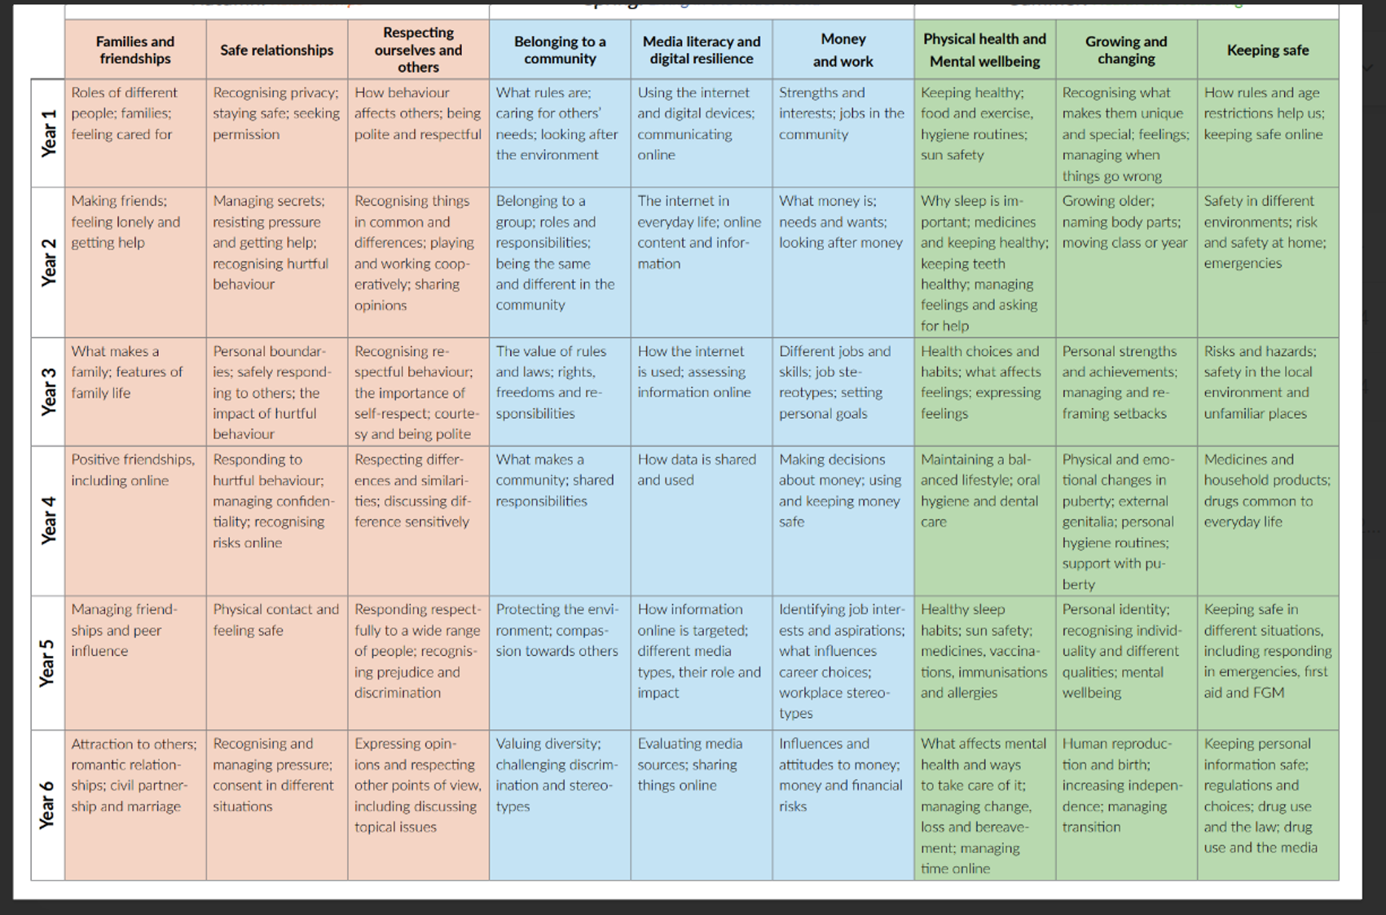
Holbrook current thematic overview

Slide 5
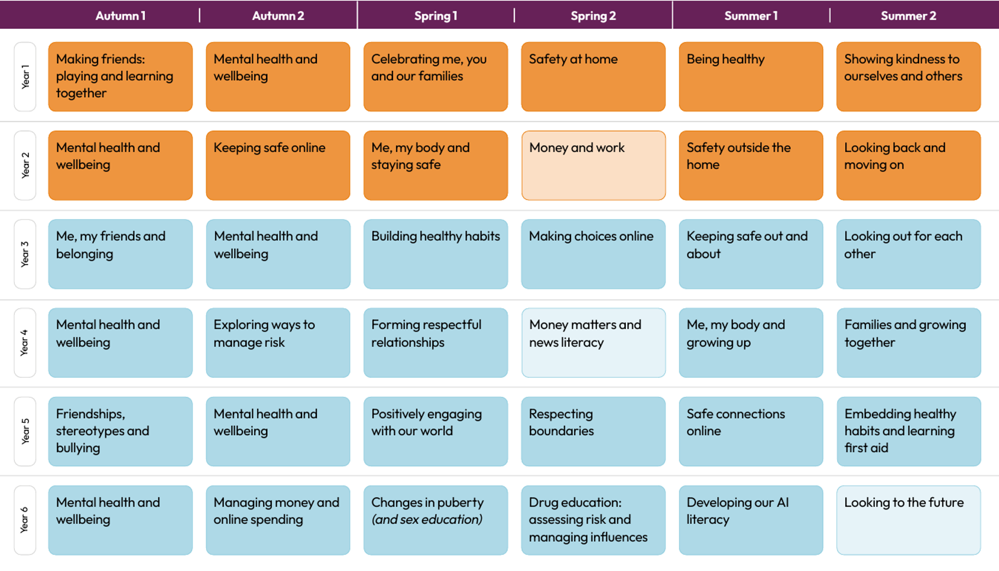
Holbrook updated thematic overview

Slide 6
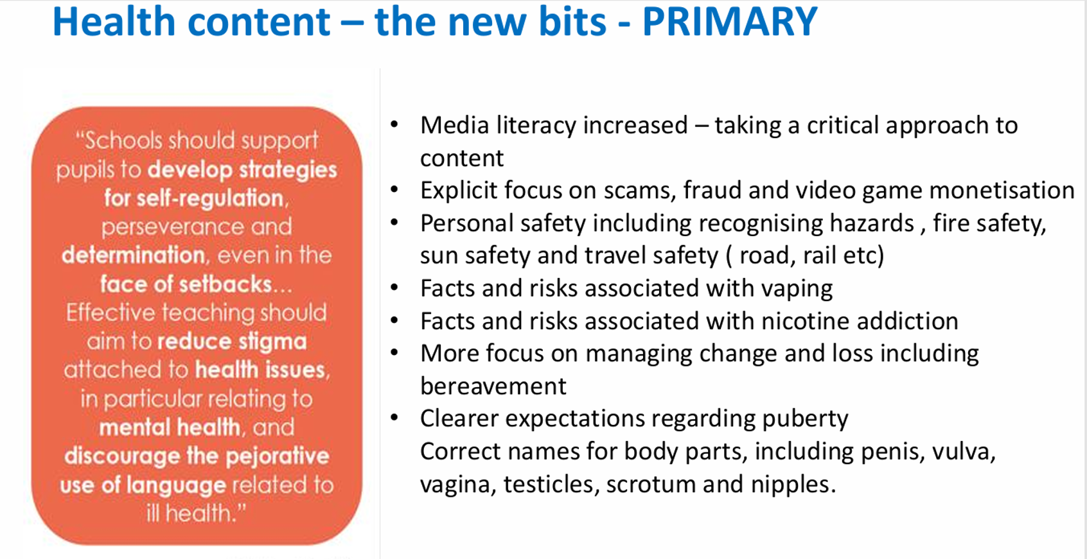

Slide 7
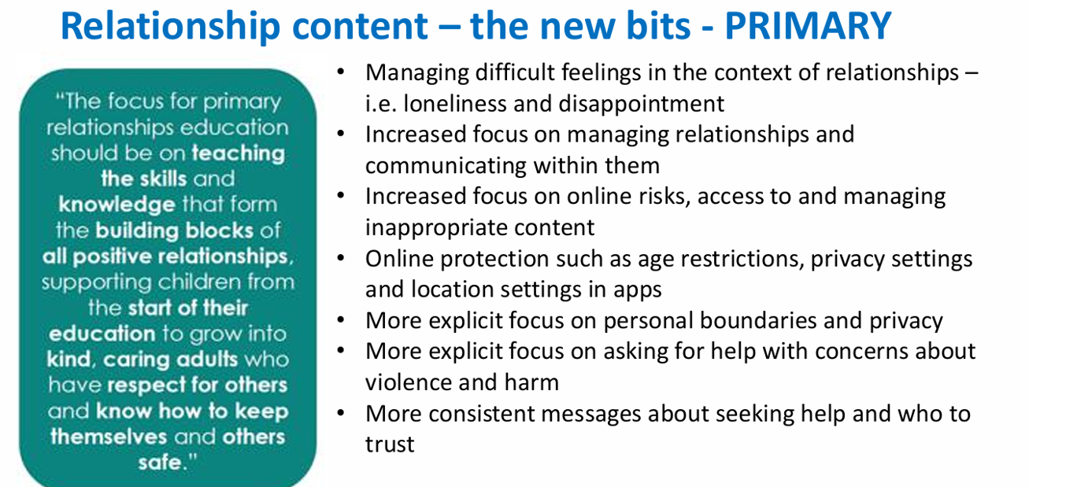

Slide 8
Main changes for our KS1/2 curriculum
  Mental heath/ grief/ loss and bereavement
  Understand body and changes – correct terminology for private parts genitalia –essential for safeguarding
•Inclusion of personal safety – fire/ water/ roads/ railways
•Promote healthy norms among relationships
•Different types of families
•Online safety and wellbeing – online scams – gambling/ gaming etc – critically engage

Slide 9


Slide 10
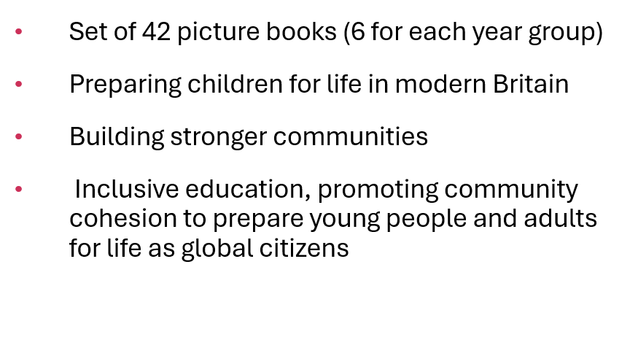
NO OUTSIDERS

Slide 11
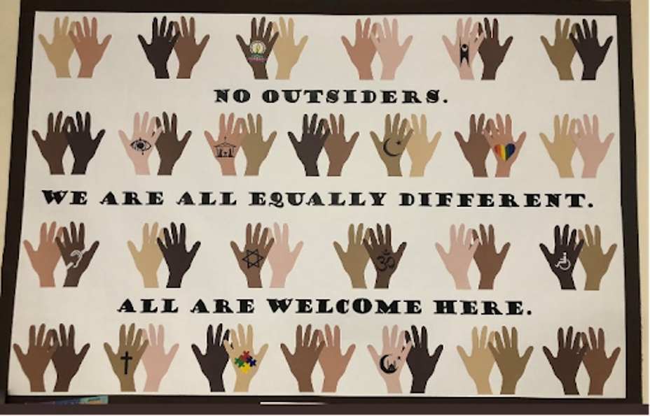
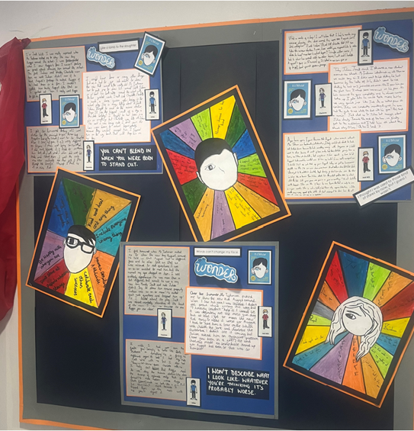


Slide 12
“Every child knows what it feels like to be left out and no child wants to be left out. No Outsiders is a powerful message for a four-year old – we play together here, no one is left out, no one is an outsider. Further up the school, we start talking about ways people are different and how we make sure in our school everyone knows they belong. Our language and our behaviour has an impact on others”.
HOW DOES IT WORK?
e

Slide 13
Please enjoy looking at the different year group books

Slide 14
QUESTIONS
Parents retain the right to withdraw their child from Sex Education at primary and secondary school. The right to withdraw refers only to the Sex Education element of RSHE. Parents are not able to withdraw their child from Relationships or Health Education.

