Slide 1

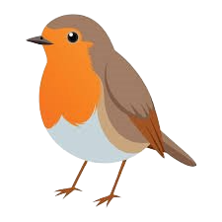


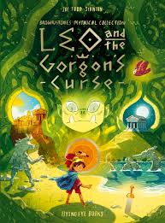
Year 3 Summer Term
Information for Parents
Dear Parents/ Carers,
We have put together some information for this term, which outlines what we will be learning- along with some helpful guidance on being prepared for a successful summer term in Year 3.
Summer Term Learning Theme: Legendary Earth
Science – Roots and shoots and artful flowers, fruits and seeds.
History - Ancient Greeks – Who were the Ancient Greeks? What did the Ancient Greeks accomplish?
What were their achievements?
English – We will be reading books linked to our learning theme including newspaper reports, Greek myths and legends, Leo and the Gorgon’s Curse, and Theseus and the Minotaur.
Maths- Continuing fractions, telling the time, shape, money and statistics. Any pre-learning that you can do with your child to help them to tell the time to the nearest minute on an analogue clock will be of benefit for their class work.
Greek Day – we would like to hold an Ancient Greek immersion day on Friday 15th May. Advance warning! The children will be invited to wear an Ancient Greek style outfit on this day (a simple white sheet/ pillowcase based outfit is fine.) The cost of resources and food will be covered by the money that the Friends of Holbrook kindly allocate every year for curriculum enrichment.
Home Learning/ Seesaw
Home learning will be uploaded on to Seesaw each Friday- the children should complete this at home and upload their work by the following Thursday morning before school.
Regular reading- This is really important for developing fluency in both reading and writing. It would be helpful if your child chooses books from a range of different authors and genres. We discuss book choices in class and are always happy to recommend a good book to the children. We will also be inviting the children to join in with our summer reading challenge, encouraging the children to read for 10 minutes every day and record their progress.
Weekly spellings (10) these should be practised little and often throughout the week.
A maths times table task, which is linked to our Bronze, Silver and Gold times table challenges.
Year 3 Expectations
The children should be organised and independent.
PE lessons will continue on Tuesdays and Thursdays- remember they need to be in the correct Holbrook PE kit. We will start our next block of eight weeks of swimming lessons starting from Thursday 7th May.
Equipment- children are responsible for their own stationery - this will need replacing regularly so please check with your child that they have everything they need. Contents should include whiteboard pens, glue sticks, a green biro or pen, a blue biro for maths, 2b pencil, HB pencil, enclosed pencil sharpener, colouring pencils, ruler and a black handwriting pen for best pieces of work.
We hope that you all had a lovely Easter Break and look forward to sharing our learning this Summer Term.
If you have any questions, then please use the class emails provided below.
wrens@holbrookprimaryschool.com robins@holbrookprimaryschool.com
Thank you for your continued support.
Miss Midmer and Mrs Noake

