Slide 1
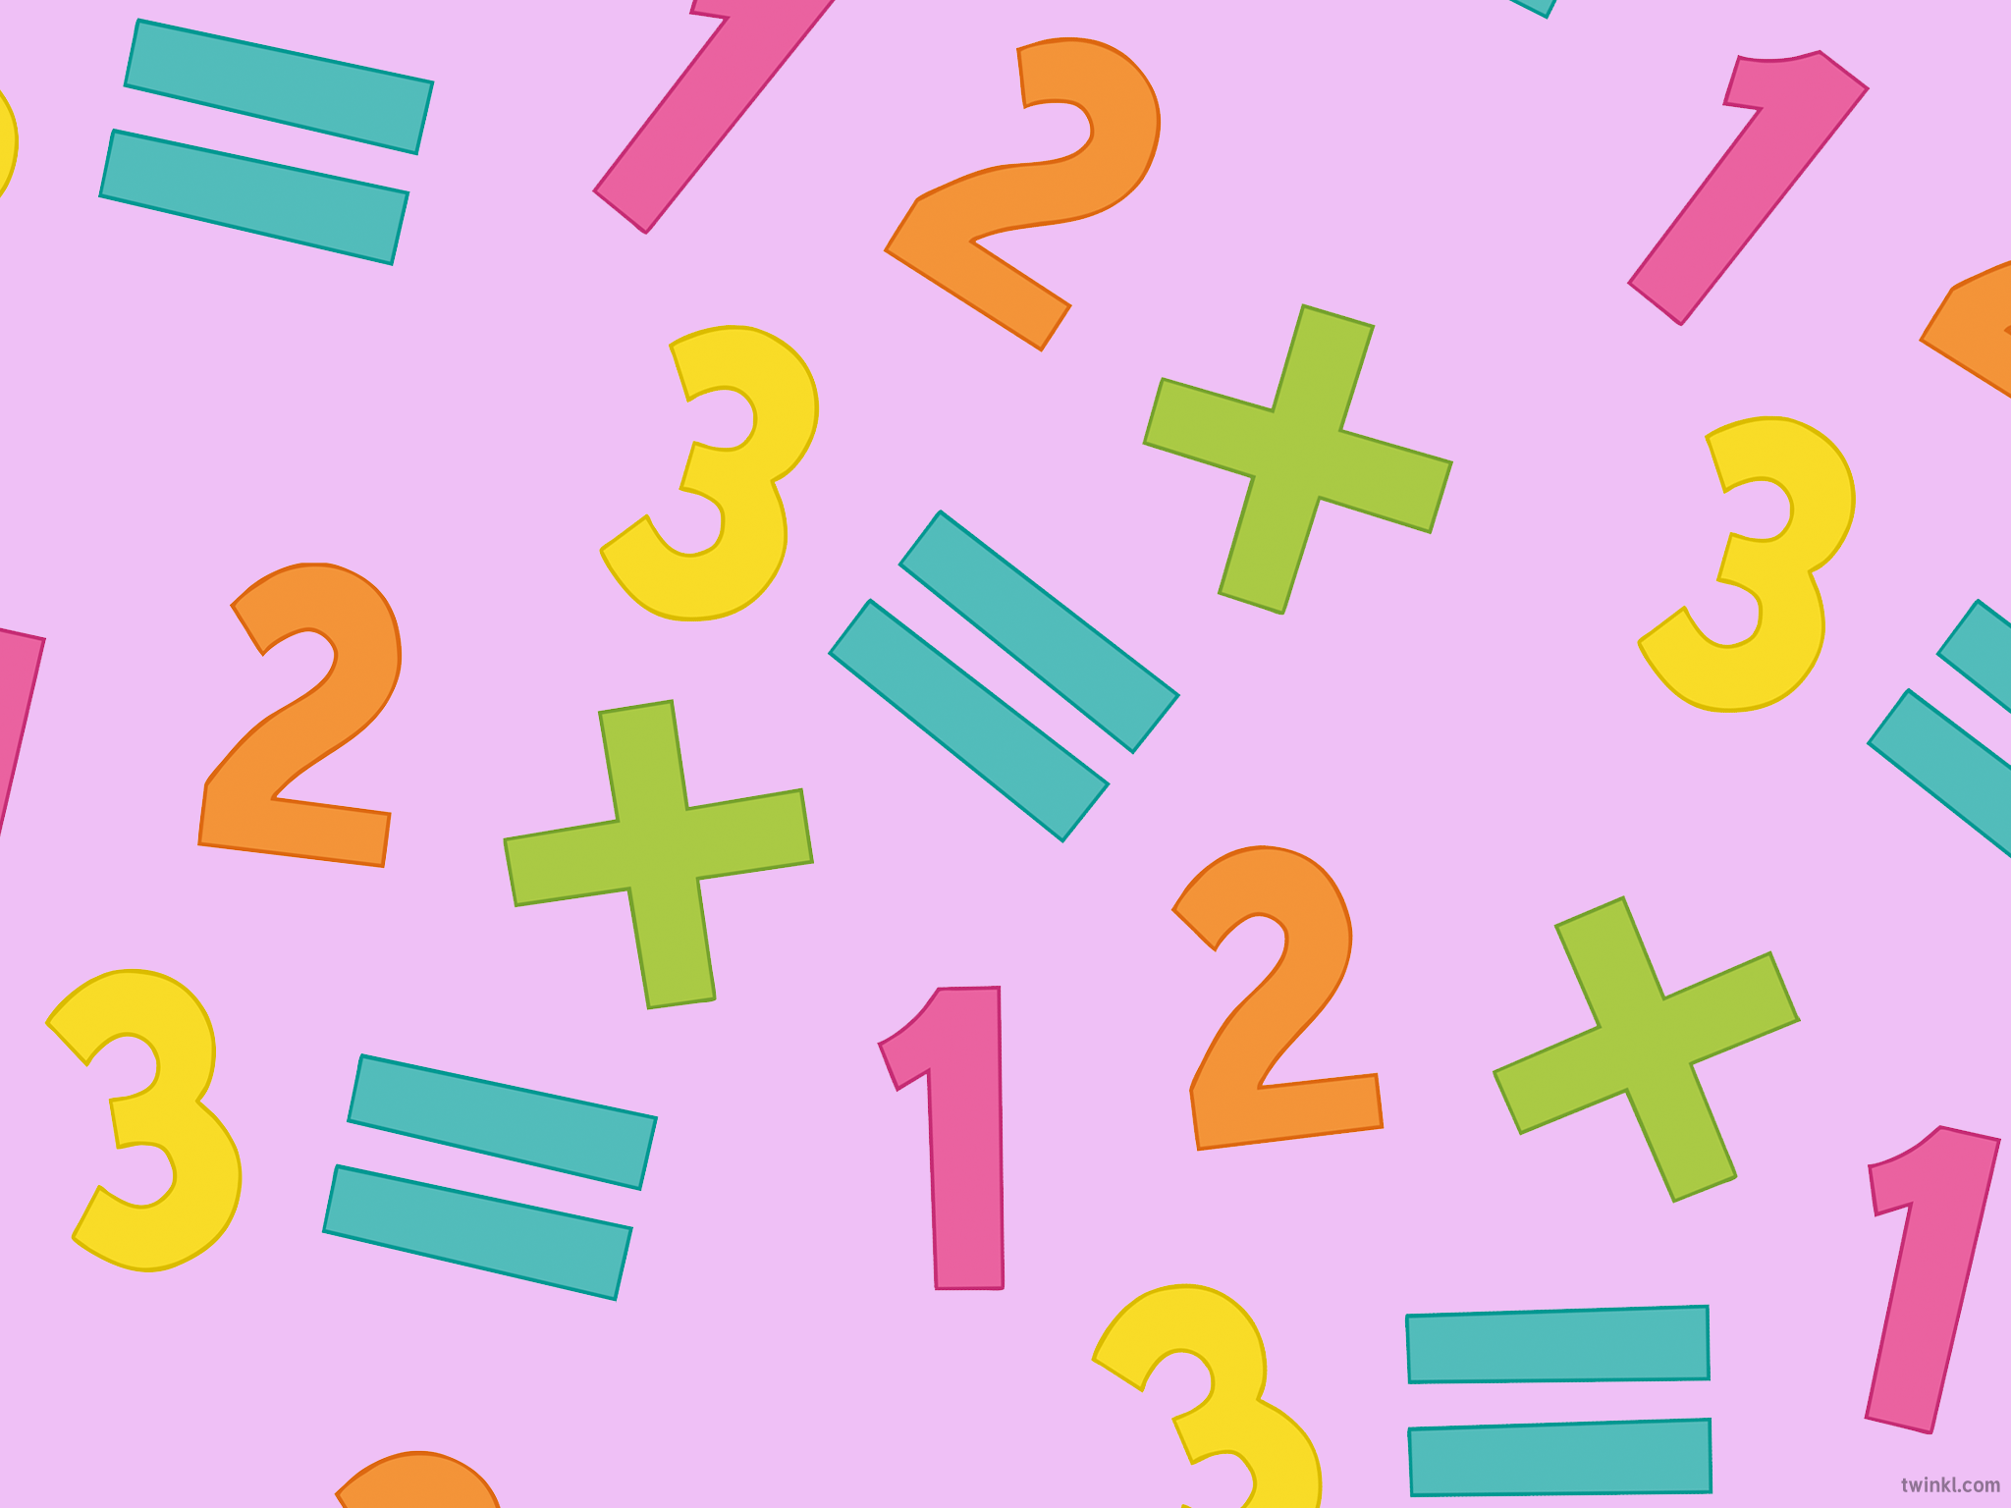
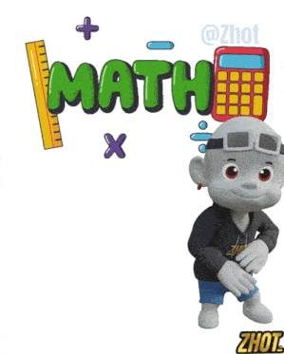
Maths Fluency
Friday 23rd January 2026

Slide 2




Slide 3
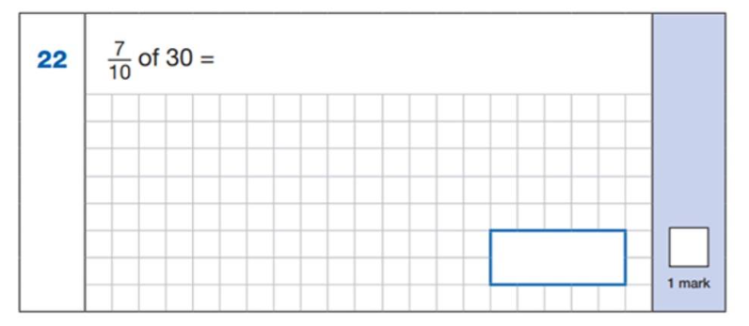
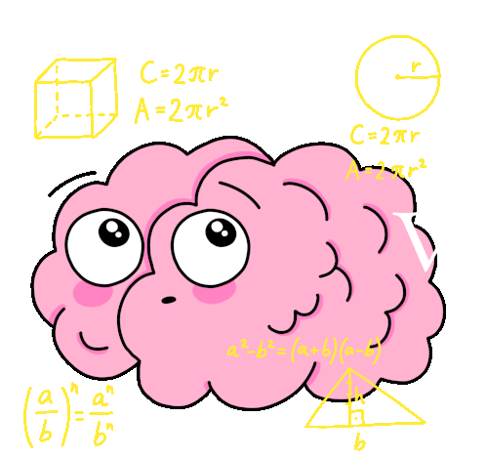
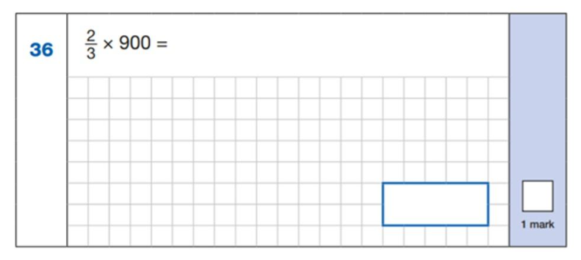
We cannot start a maths morning
without a little bit of maths…
Both of these questions are from the 2023 Year 6 arithmetic paper!

Slide 4
What Is Maths Fluency? Why Does It Matter?
When we talk about being ‘good at maths’, we don’t just mean getting answers right. We mean children feeling confident and flexible when they work with numbers.
Maths fluency is about understanding numbers, recalling key facts, and knowing how to use numbers in different ways.
You can think of fluency a bit like reading fluency — when children don’t have to sound out every word they can focus on meaning.

Slide 5
What Is Maths Fluency? Why Does It Matter?
When children are fluent with numbers, their brains don’t have to work so hard on basic facts. That frees them up to think about problem-solving and reasoning.
It also helps reduce anxiety. Children who feel confident with numbers are more willing to try, even when something looks tricky.
Strong maths fluency supports learning in other subjects like science, computing, and working with money.

Slide 6
What Is Maths Fluency?
Maths fluency is a child’s ability to understand numbers, use them flexibly, and recall key facts easily.
It has three parts:
Efficiency – choosing most efficient method
Not counting everything one by one if there’s a quicker way.
Accuracy – getting the correct answer
Careful but not slow.
3.Flexibility – using numbers in different ways
Knowing that 7 + 3 is the same as 10 – 3.
Fluency is not just speed and not just times tables.
It’s about understanding why maths works.

Slide 7
What Maths Fluency Looks Like in Children
A fluent child might:
Instantly know that 8 + 2 = 10
Break 17 + 6 into 17 + 3 + 3
Explain their thinking in simple words
Spot mistakes and correct them
Feel confident trying different strategies
What it doesn’t look like:
Racing to finish work
Memorising without understanding
Panicking when numbers look unfamiliar
Fluency develops over time – it’s built through regular, small practice, not pressure.

Slide 8
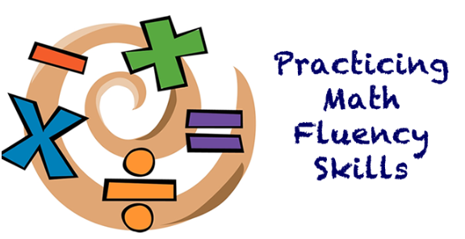
How We Build Maths Fluency at School
At school, children develop fluency through:
Regular short practice
Talking about their thinking
Using concrete resources (counters, cubes, number lines)
Revisiting key facts often
Making links between different methods
The learning of key facts each half term (KIRFs)

Slide 9
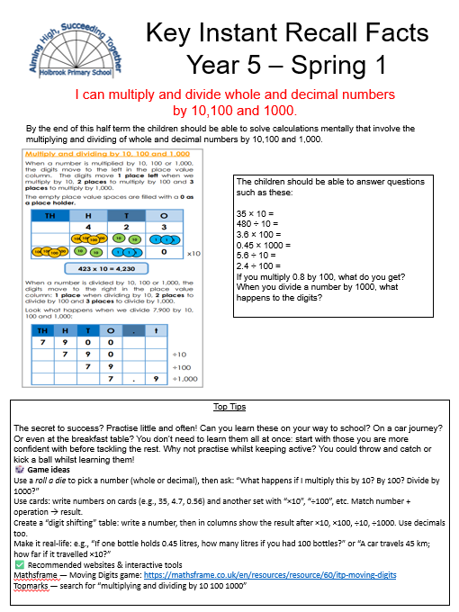
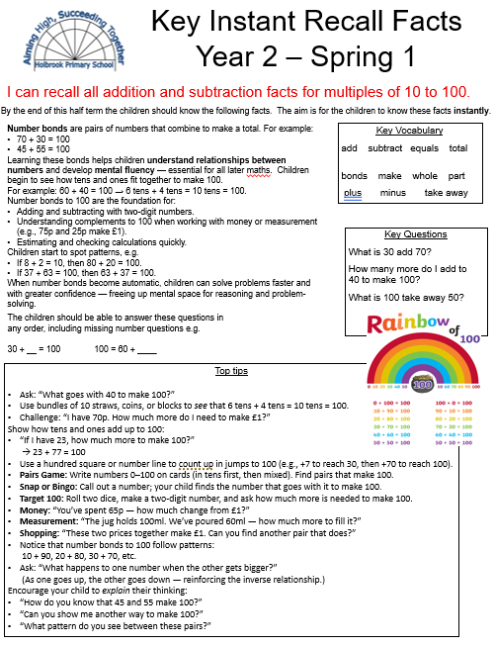

Slide 10
KIRF’s
Build maths fluency
Sent home every half term
Key Instant Recall Facts
Support progress across all areas of maths
Free up working memory
Support confidence and reduce anxiety
Notes:
Why are KIRFs important?
1. They build maths fluency
Fluency means children can work accurately, efficiently and confidently.
If children don’t have to think hard about basic facts, they can focus their thinking on the new learning.
For example:
If a child knows instantly that 7 × 8 = 56, they can concentrate on solving a word problem rather than getting stuck on the multiplication.
2. They free up working memory
Children only have a limited amount of “thinking space”.
When basic facts are automatic:
There is more room in their brain for reasoning, problem solving and explaining their thinking
Maths feels less overwhelming
3. They support confidence and reduce anxiety
When children know facts instantly:
They feel more confident
They are more willing to take part in lessons
Maths feels quicker and more enjoyable
Struggling with basic facts can make maths feel slow and frustrating.
4. They support progress across all areas of maths
Instant recall facts aren’t just for tests or times tables.
They help with:
Written calculations
Fractions, decimals and percentages
Measurement and geometry
Problem solving and reasoning
Strong foundations make later maths much easier.

Slide 11

How are the KIRF’s taught?
One set of facts is focused on at a time
Children practise them little and often
Revisited regularly, so they move into the long-term memory
Speed comes after understanding, not instead of it
Notes:
One small set of facts is focused on at a time
Children practise them little and often
They are revisited regularly so they move into long-term memory
Speed comes after understanding, not instead of it

Slide 12
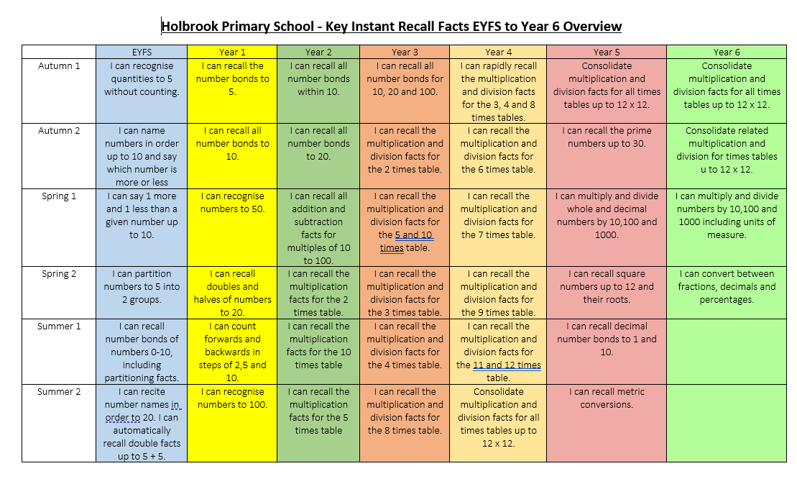

Slide 13

Helping with maths fluency at home

Slide 14
1. Little and often
Fluency improves best with short, regular practice.
2. Talk about maths
Fluency is not just about worksheets.
Try:
Quick oral questions
Saying facts out loud
Asking children to explain how they know an answer
Examples:
“What’s 6 + 4?”
“How do you know that?”
“Can you tell me another way?”
3. Practise key facts regularly
Children benefit from instant recall of:
Number bonds
Times tables and division facts
Doubles and halves

Slide 15
4. Use games
Games make practice feel enjoyable and low-pressure.
Card games (snap, make 10, higher/lower)
Dice games (add, subtract, multiply the numbers)
Board games that involve counting or totals
55. Use maths in everyday life
Maths is everywhere – point it out!
Examples:
“We need 6 apples. We’ve got 2 – how many more?”
“If one costs £3, how much for two?”
“Half the pizza has gone – how much is left?”
Be positive about maths
You don’t need to be a maths expert. Short, positive conversations about numbers make a huge difference.

Slide 16
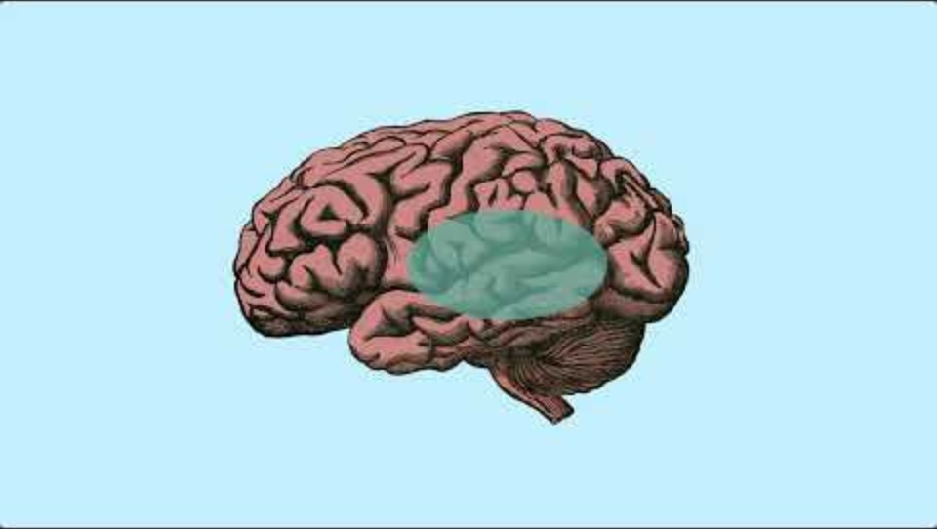
A short video to consolidate some of the key points
Notes:
https://www.youtube.com/watch?v=eQ2mwuNnNd8

Slide 17
Maths in the Classrooms
EYFS: Composition of number 5.
Year 1: To use solving problems using addition and subtraction facts.
Year 2: To use number facts to help us solve problems involving 2D shapes.
Year 3: A times table investigation linked to art.
Year 4: Investigating and problem-solving with times tables.
Year 5: To use multiplication and division skills when problem-solving.
Year 6: Verbal sequencing linking to algebra.
We encourage you to visit different classes to get a taste of maths across the school.

