Slide 1
Phonics at Holbrook
Reception 2025

Slide 2
Our Aims
To introduce phonics terminology
To become familiar with the different stages of phonics teaching
To gain more knowledge of practical activities you could do with your child at home

Slide 3
Revision
What is phonics?
Phonics is a method of teaching beginners to read and pronounce words by learning to associate letters or letter groups with the sounds they represent.

Slide 4
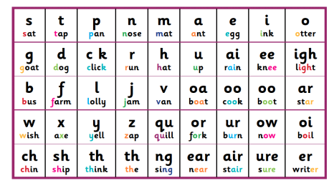
What do these phonics terms mean?
Phoneme – the smallest unit of sound.
Grapheme - A grapheme is a written symbol that represents a sound (phoneme). This can be a single letter, or could be a sequence of letters, such as ai, sh, igh, tch etc. So when a child says the sound /t/ this is a phoneme, but when they write the letter 't' this is a grapheme.
Digraph - A digraph is two letters that make one sound. The digraph can be made up of vowels or consonants.
Trigraph - A trigraph is a single sound that is represented by three letters
Tricky words – words that are not fully decodable using the phonics they have been taught e.g. ‘was’ or ‘the’
Segmenting - breaking words down into individual sounds or syllables.
Blending – putting the individual sounds they have learnt together. This means that they will learn to look at a short word, such as 'tin' and rather than saying three separate sounds 't', 'i', 'n', link the sounds together and say the whole word in one go.
Notes:
Phoneme - The smallest unit of sound in a word.
There are around 44 phonemes that we teach.
Grapheme – the written representation of a phoneme
Digraph – 2 letters making one phoneme
Trigraph - 3 letters making one phoneme
Tricky words – words we cant sound out
Blending - Recognising the letter sounds in a written word, for example
c-u-p
and merging or ‘blending’ them in the order in which they are written to pronounce the word ‘cup’.
We also use the phrase ‘sound-talk’ to help the children understand the concept
segmenting - Chopping Up’ the word to spell it out
The opposite of blending

Slide 5
Pre-phonics skills
It is important that, prior to starting to teach the individual phonemes, children have had the opportunity to:
Listen and distinguish between different sounds in the environment
Learn rhymes and songs
Make sounds using objects/ instruments/ their bodies/ their voices
Notes:
Mostly covered in nursery or preschool and ongoing throughout reception year
Importance of nursery rhymes etc.

Slide 6

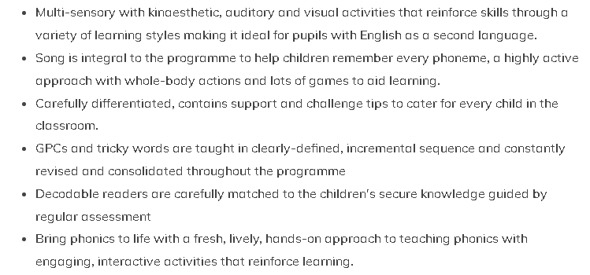

How we teach Phonics at Holbrook
Notes:
Into our third year now – seen great results, children enjoy the song, pick up the phonemes quickly

Slide 7
Song of Sounds Stage 1
During the Reception Year the children will be taught:
To recognise and write approx. 45 different phonemes
To orally blend to read and segment to spell
Read and spell regular ‘green’ words using the phonemes taught
To read regular two-syllable words and simple captions
Some tricky ‘Red’ words
Learn letter names and capital letters

Slide 8
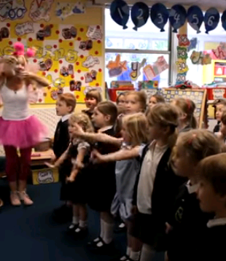
The Song
The song:
https://youtu.be/UdWOstqf3hU
The actions
https://youtu.be/o3mAgyNOINE
Notes:
Introduced to the children very early on. Exposes the children to all of the phonemes covered in the year straightaway, Some children pick up on ones before they are formally taught
Pictures/phrases to go with each phoneme
Wall frieze in classroom, phoneme finder cards, chn encouraged to use them and sing the relevant part of the song if they need to
Show phoneme cards

Slide 9
Lesson Structure
4x15minute whole-class sessions a week, focus teaching e.g. a phoneme or tricky word, blending, segmenting, syllables
Consolidation session at end of the week revising the teaching focus from the week.
Taught through a variety of adult-led activities within differentiated groups.
e.g. bingo, Splat, word hunts, matching/pairs games, board games
Notes:
Show some examples

Slide 10

The GPCs taught in Stage 1
Felicity the Phoneme Fairy introduces the children to the different phonemes and their corresponding graphemes (GPCs)
Many are single sounds such as ‘s’ and ‘a’ but we also teach digraphs (2 letters, one sound) such as ‘ai’ and ‘sh’
Notes:
Explain GPC
Revise terms – grapheme, digraph, trigraph

Slide 11
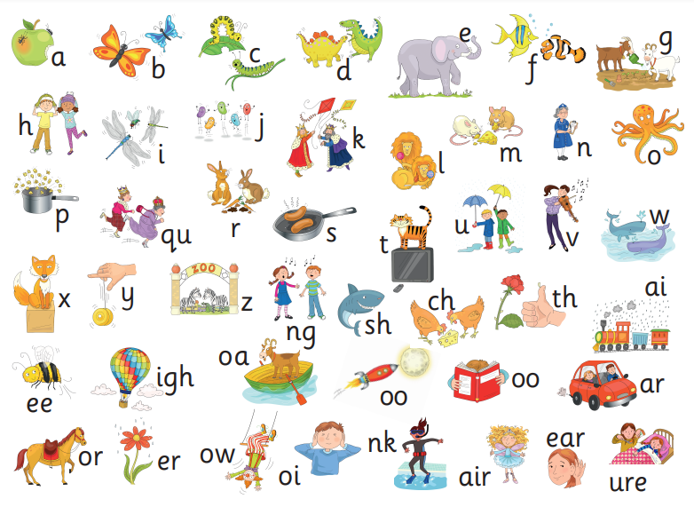

Stage 1
Notes:
Started off teaching one sound a day so x4 a week
Began using to read vc and cvc words almost straightaway

Slide 12
VC/ CVC /CVCC/CCVC words
C = consonant
V = vowel
VC words - if, on, it
CVC words – cat, hop, ship,
CCVC words –frog, twin, drag
CVCC word – nest, wind, pink
Notes:
We do start blending straight away to read the green words
Already reading CVC words! CCVC CVCC words in Spring term

Slide 13

Blending to read
Green words with sound buttons
Bert the word builder
Notes:
Can help children when reading if stuck on a word - can they spot the digraphs?
Encourage oral blending if they are struggling to blend by themselves
I.e. adult to say the individual sounds/phonemes first and child to say the word
Bert the builder shows how the individual phonemes move together to build a word. Physical and very visual representation of blending

Slide 14

Blending to read
Have a go! Place a under single sounds such as ‘t’ and
then a under vowel/consonant digraphs such as ‘ck’ or ‘ee’
Can you sound button these words?
duck fair tree
pondweed lightning
Notes:
Can help children when reading if stuck on a word - can they spot the digraphs?
Encourage oral blending if they are struggling to blend by themselves
I.e. adult to say the individual sounds/phonemes first and child to say the word
Bert the builder shows how the individual phonemes move together to build a word. Physical and very visual representation of blending

Slide 15
Blending to read
Have a go! Place a under single sounds such as ‘t’ and
then a under vowel/consonant digraphs such as ‘ck’ or ‘ee’
Can you sound button these words?
duck fair tree
pondweed lightning
Notes:
Can help children when reading if stuck on a word - can they spot the digraphs?
Encourage oral blending if they are struggling to blend by themselves
I.e. adult to say the individual sounds/phonemes first and child to say the word
Bert the builder shows how the individual phonemes move together to build a word. Physical and very visual representation of blending

Slide 16
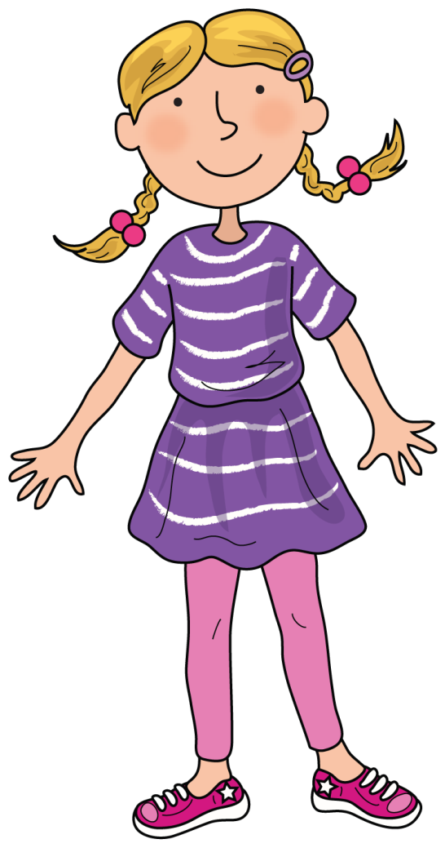
Segmenting to Spell
Sound talking
Phoneme fingers
Syllables (Sally Syllable)
Notes:
Begin by sound talking words
Move on to counting phonemes – phoneme fingers
Draw the sound buttons to help ensure all sounds are recorded
Expectations – phonetically plausible i.e. rayn (unless tricky words already covered in class )

Slide 17

Stage 1Tricky Words
Tricky Trevor helps to introduce the words
Red and spiky to encourage STOP and THINK
Notes:
Red and spiky – stop and think as cannot sound them out hence the word ‘tricky’

Slide 18
Captions
Once the children have learnt GPCs and some tricky words they will be ready to have a go at reading and writing captions.
For example...
Pat a dog.
A cap on a peg.
Get off the bus.
Notes:
When reading encourage children to say the word again after they’ve sounded out and to recap throughout the caption

Slide 19
Reading
Early days! As a school we want to foster a love of books and reading first and foremost, so please continue to share your favourite bedtime stories etc. together.
Your child will be able to bring home a picture book to share with you. These are for you to read to your children. Encourage your child to use the illustrations to verbally create their own stories and predict what will happen next/summarise what has happened, talk about the characters etc
Once children are familiar with a range of phonemes and are starting to blend the sounds to read, they will be sent home with a ‘Felicity Phonic reader’ book. The children should be able to read these books independently. We would encourage you to allow your child to re-read these books at least 3 times to build up their confidence, fluency and expression. They should contain GPCs your child can recognise and use to blend.

Slide 20
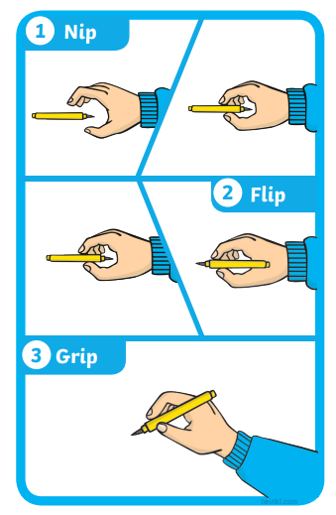
Writing
As the children progress through the phonics scheme, they will become better and better at identifying the graphemes (letters) that represent the phonemes (sounds) which will help them with their independent writing.
Alongside this they will need the gross and fine motor skills that enable them to write the letters, and this is something that varies considerably from child to child.
We will be working on developing these skills in class, with varied activities from large scale painting and sweeping, to wall press ups to improve their gross motor skills, and for the fine motor skills we will be using things like tweezers and threading and Play-Doh to ensure that children develop the skills necessary.
We still very much value all kinds of writing and mark-making, so please do let the children see you making lists/writing messages, and value the marks they make while attempting to copy you!
We are also working hard on writing their name, so this can be encouraged in card writing/thank you letters etc. (Capitals for first letter only if possible please!)
Correct pencil grip is also something we value your support with - plenty of advice on the internet with demonstrations, but we like the ‘nip/pick, flick and grip’ advice! (Again, this is something your child may not be physically ready for, so do not feel you have to push it if they are not ready.)

Slide 21
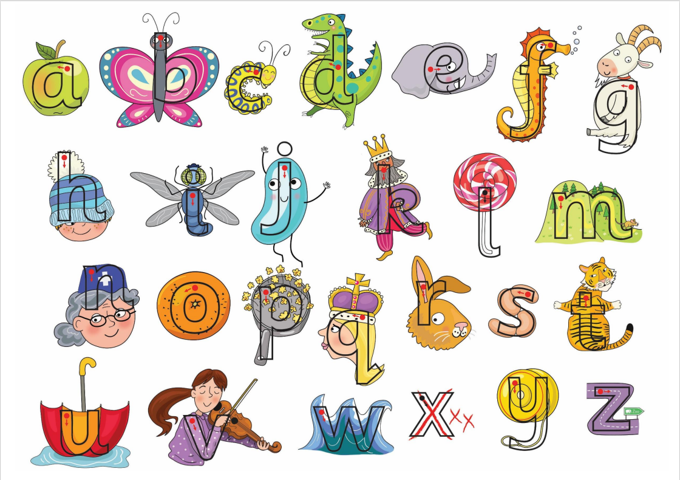

Slide 22

Thank you for your time.
If you have any queries, please contact your child’s class teacher via their class email address. hedgehogs@holbrookprimaryschool.com otters@holbrookprimaryschool.com
Notes:
Evaluation

