Slide 1
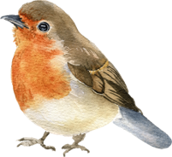
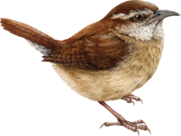
YEAR 3
AUTUMN 2025
Parent and Carer
Information Meeting
Aiming high, succeeding together
Notes:
EM

Slide 2
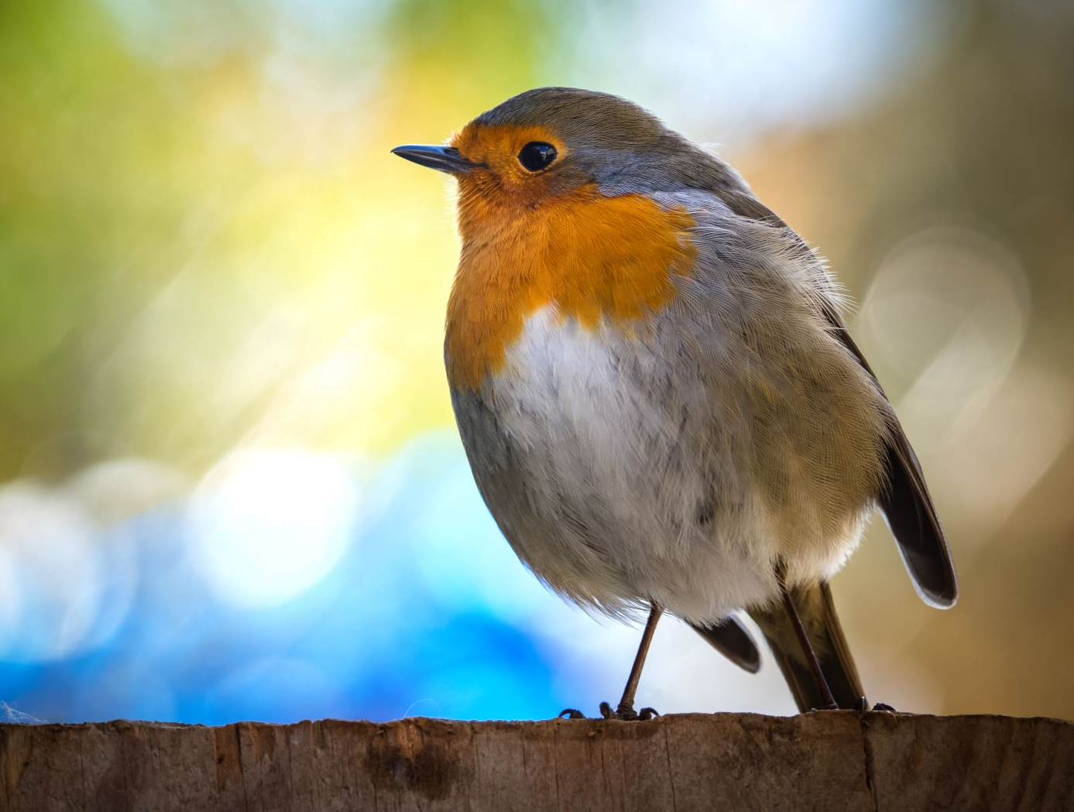
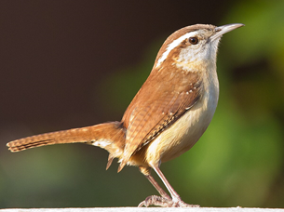
Year 3 Staff 2025
Robins
Mrs Noake
Wrens
Miss Midmer
Support Staff
Miss Windwood, Mrs Roberts,
Mrs Cable, Mrs Beales

Slide 3

What are our goals for year 3?
Happy children, who enjoy their time in year 3 and who love coming to school.
To become more independent learners.
Continued strong development of friendships.
To gain additional knowledge, skill and confidence across all areas of the curriculum.

Slide 4


TEAM skills

Slide 5
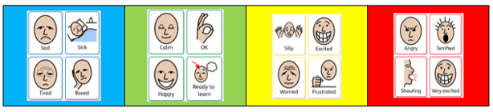
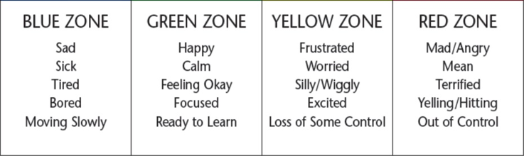
Zones of Regulation

Slide 6

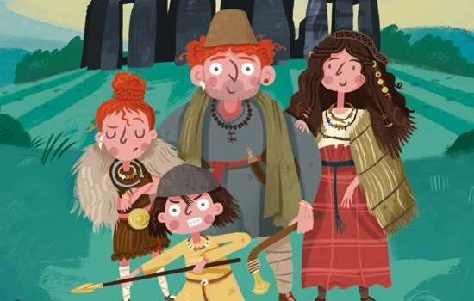

Our learning themes
Autumn Term –Precious Earth
Spring Term – Wild Earth
Summer Term – Legendary Earth
Notes:
Autumn Term – started working on the Stone Age, then will move onto the Bronze and Iron Age. Talk about settlements.
Talking about precious Earth we then love onto looking at our local area and look at plastic pollution.
Spring Term – Floods, earthquakes and volcanoes
Summer Term – myths and legends and then we look at Ancient Greece.

Slide 7
What is expected in Year 3?
Independence
It is expected that children will take responsibility for themselves and their belongings. This could include:
coming in to school independently
end of school arrangements i.e. clubs, who is collecting etc.
remembering to change books
remembering to complete Home Learning and ensure it has been done/uploaded and take home other letters / reply slips

Slide 8
What is expected in Year 3?
looking after their own belongings i.e. pencil cases, whiteboard and pens and having them ready.
We change the seating plans regularly to allow children to work with a range of learning partners and abilities.

Slide 9


Slide 10


Slide 11
Trips & Visitors
Autumn Term | Butser Ancient Farm
Spring Term | Swimming
Summer Term | Swimming Ancient Greek Workshop

Slide 12


PE
Outdoor PE: Tuesdays​
Indoor PE: Thursdays
​
Earrings should be taken out for PE (ideally at home), or if they cannot be removed, covered by tape provided from home.
​
Verrucas should be covered for indoor PE and swimming.
Swimming kit on Thursdays for spring and summer term.

Slide 13

Home Learning
In year 3 home learning will include regular reading, and other skills based work such as spelling and maths.
Your child will have been sent home with their new home learning books and inside you will find their logins for Seesaw and other websites that are useful.
Homework will be set on a Friday and is due in by the following Thursday (before school).
Children should be spending approximately 30 mins per week on Home Learning in year 3. Weekly reading is additional to this. They are of course welcome to do other tasks that they enjoy, such as Times Tables Rockstars or Spelling Shed, but the set task will vary.
The children can use the features on Seesaw, such as notes or photos / videos to respond to work. If they would rather, they can also write down their work in their home learning book and send a picture to us as evidence.
Notes:
CN

Slide 14
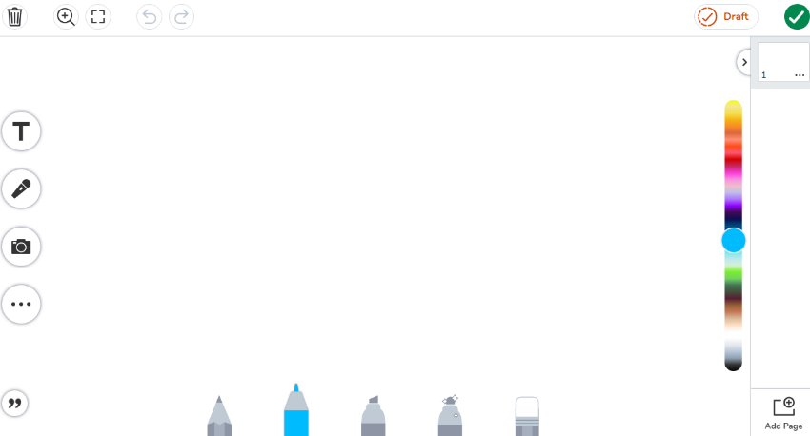
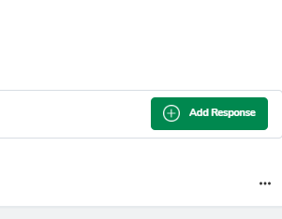
Seesaw
Please upload home learning by Thursday morning to allow us time to properly look at what they have done.
It is easier to find their work if you add it via the ‘Add Response’ button, as Seesaw attaches it to the activity correctly.
Simply click here to add new pages if you are uploading more than one bit of work

Slide 15
Reading Diaries
Reading diaries are for your child to share with their teacher the range of texts they are sharing at home. This can be simple comments, book reviews, activities set for Home Learning, character profiles etc. The books also include updated author suggestions etc.
Children/parents/carers record their reading by writing the date, author and title.
We would encourage you to read daily. Our home learning policy states 5 times a week. This could include texts your child has read themselves as well as texts you have shared together e.g. bedtime stories.
Please ensure that they are brought into school every day ideally, but always on a Friday as this is the day that they will be checked by the class teacher.

Slide 16


Reading – How you can help​
  Encourage your child to read at least five times a week.
  Share books with them.​
  Many children enjoy silent reading, but it is also important for them to practise reading aloud. ​
  Take turns reading with your child.
​
  Audio books are fantastic, as they expose children to words they might otherwise find hard to access, as well as new authors and ideas.​

Slide 17


Speedy tables
In addition to the year 3 maths curriculum, the children will continue to work on their times tables in preparation for the national year 4 multiplication tables check.
We will start with revising the tables from year 2 – 10, 5, 2.
The year 3 times tables are 3, 4 and 8.
Children have access to Times Tables Rockstars – logins are in their Home Learning books.

Slide 18
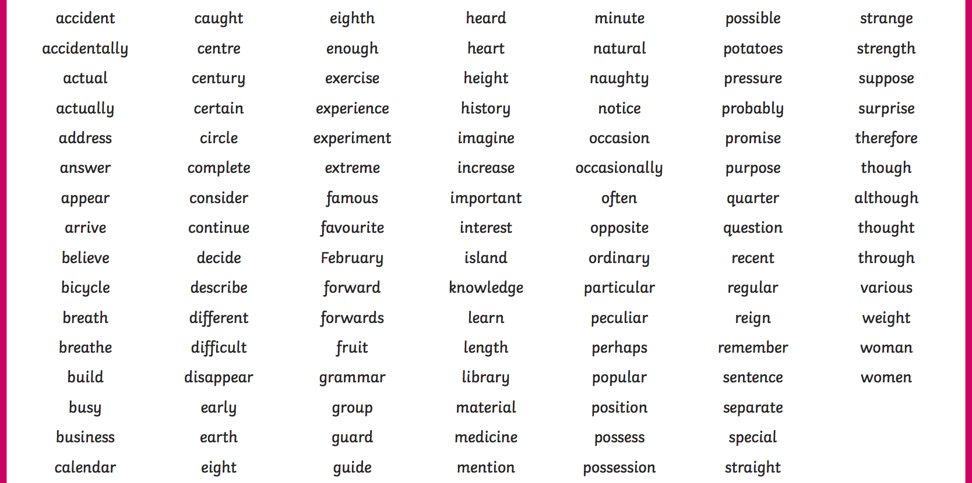

Year 3 and 4 Statutory Spellings
Throughout year 3, we learn a range of spelling rules, including a range of prefixes and suffixes.
Lots of our spellings will be covered through our weekly spelling work.
Any additional practice will make a huge difference!

Slide 19

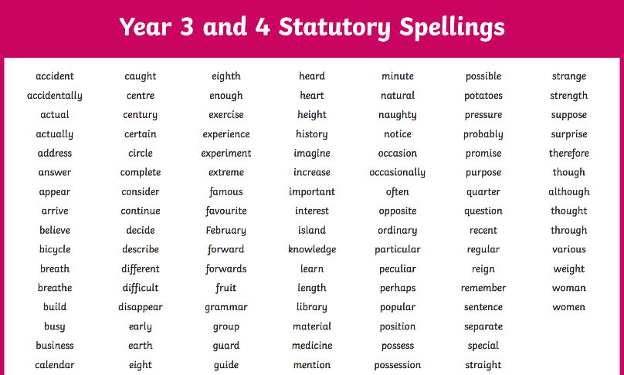
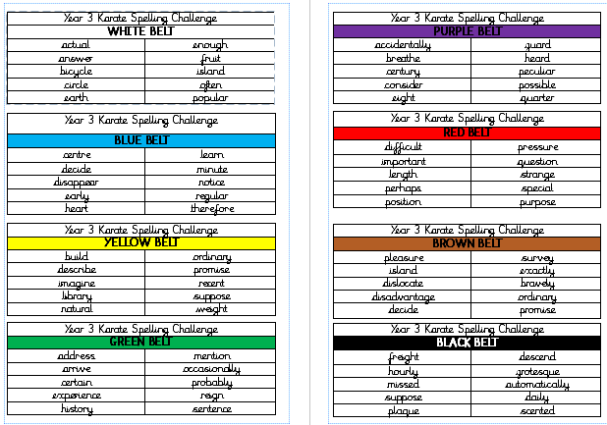

Karate Spelling Challenge for Year 3
All children will experience the karate bands at the same time across the year group. These will be tested in class (you will notified in advance via Home Learning on Seesaw.) The idea is that all children will be aware of what the statutory spellings for year 3/4 are, even if they are not yet ready to spell them independently from memory (i.e. they know that these are words they should be looking up on word mats etc.) Not all children will be expected to know all of the spellings or take part in the tests, but they will be expected to look them up/use their word lists etc.

Slide 20
Karate Spelling Challenge for Year 3
Those that do not pass the first time are offered the chance to retest – they will need to ask an adult for this.
Spelling Shed – children have the logins for this in their Home Learning book. There are lots of fun games to help consolidate both the weekly year 3 spelling patterns (not formally tested in school) and the Karate Challenge words.
The booklet will be saved on your year group Seesaw, but please ask if you require a paper copy.

Slide 21

How can parents support?
Regular stationery checks.
Encourage independence​.
Hear your children read regularly​ and ensure they are reading 5 x a week and updating their reading diary, as well as recording on Seesaw where appropriate.
Support your child with the learning of their times tables, number bonds and telling the time.

Slide 22
Contact & Social Media
Our class email addresses are:
robins@holbrookprimaryschool.com
wrens@holbrookprimaryschool.com
Please email rather than messaging on seesaw for any queries that are not relating to home learning
School twitter - @PrimaryHolbrook
School facebook – Holbrook Primary School Horsham
School website

Slide 23




Thank you for coming and listening.
A
Any questions?

