Slide 1
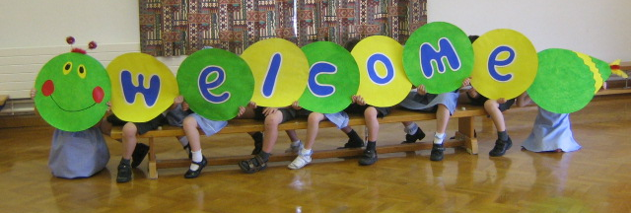
Welcome to
Reception
Tuesday 23rd September, 2025
2.30pm

Slide 2
Reception Staff
Mrs Harman & Mrs J Wright– Class Teachers
Mrs Bayliss & Mrs Kemp - Teaching Assistants
Mrs Bell – Learning Support Assistant
PPA for Hedgehogs and Otters (Tuesday Morning) – Mrs Duo & Mrs Thompson

Slide 3
Reception Topics
We have started this year with the topic ‘Marvellous Me’. Children have shared their treasure boxes and we will be comparing themselves with their friends, thinking about how they are all special. We will be learning about their families and how they have changed since they were babies.
Some topics link themselves to real life objects and we will invite the children to bring in object from home and this will be communicated via seesaw.
Notes:
We can only give a very brief overview of our other topics as we would like to plan our future topics around the children’s interests.
previous years have been If you go down to the woods/paws/claws and fluffy tales = but may change!

Slide 4
The Early Years Foundation Stage
The Early years foundation stage curriculum has changed this year. It consist of:
3 Prime Areas:
Personal, Social and Emotional Development
Physical Development
Communication and Language
4 Specific Areas:
Literacy
Mathematics
Understanding of the World
Expressive Arts and Design
All Taught through play based learning
Characteristics of effective learning
Playing and exploring (engagement)
Active learning (motivation)
Creating and thinking critically (thinking about their own learning)
Notes:
More info via curriculum letters sent termly and uploaed onto the website

Slide 5

Reading
Here at Holbrook, we want to foster a love of reading from an early age. Your child will be bringing books home from school weekly. They will be:
A picture book – to share with an adult
A ‘felicity phonic reader’ – to read to an adult (once they are beginning to blend sounds to read words)

Slide 6
Felicity Phonic book
These are selected for your child by their teacher
Initially these may be wordless books.
Later on, they will contain decodable words that your child should be able to read independently
Encourage your child to attempt to sound out the words by themselves and to read the book several times over a few days, in order to build up their fluency and familiarity with the words.
If your child is struggling with recognition of the sounds, or blending the sounds together to read the words, please inform your child’s class teacher via the Reading Diary.
All reading should be recorded in Reading Diaries. Please include books you have read to your child as well as any school books they have read to you.
Notes:
The reading curriculum stresses the importance of decodable books and that children should only be asked to read books which contain graphemes which they recognise and tricky words they have already been taught. This is so that children can develop confidence and fluency in the very early stages of reading, whilst working with phonemes they are familiar with, rather than being faced with words or phonemes they do not know and therefore cannot decode yet.

Slide 7
Reading Diaries
Diaries are for your child to share the range of texts they are reading at home with their teachers.​
Please record their reading by writing the date and title. ​
You may wish to write a comment about your reading. ​
Try to read daily. This could include texts your child has read themselves as well as texts you have shared together. i.e. bedtime stories.​
Please ensure the diary and phonic reader is in school every day. ​
The teachers will check the diaries regularly but this diary is for you/your child to write in.
​​

Slide 8
Changing Books
An adult in school will read with every child at least once each week
Children will have the opportunity to change their Phonic reader once they have read with an adult in school and have shown they are secure with it
If they wish to change their book more frequently, they may. Please leave their reading diary in the book change box for your class, with the phonic reader tucked inside so we are aware! However, please ensure they have read the book several times and are secure with it
It is important that children are also read to and have the opportunity to share books above their reading level. However, they should only be asked to attempt to read/sound out words with phonemes they already know
Picture books may be changed whenever the children wish. They will do this independently in the classroom

Slide 9
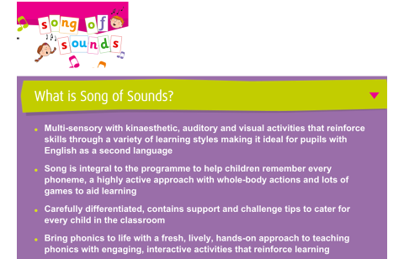
Phonics
Notes:
To be invited to workshop meeting soon

Slide 10
Handwriting at Holbrook
At Holbrook, in Reception we use a pre-cursive style of handwriting, which includes exit strokes which the children then build on in Years 1 and 2.
In Reception, our focus is on developing fine-motor skills and strength before introducing formal handwriting.
We use Song of Sounds to support our handwriting. Links and resources will be added to Seesaw.
Letterjoin website – demonstrates the correct formation - home login available – will be added onto Seesaw

Slide 11


Slide 12

Learning skills

Slide 13


Slide 14
Animal Adventure
Prickles and Otto
Each Friday a child will get the opportunity to bring home Prickles the hedgehog or Otto the otter for the weekend.
Record your adventures together on Seesaw which will be shared with the class the following Friday.
Please bring them back on Monday.

Slide 15
Supporting at Home
Observations from home uploaded to seesaw
Phonics - ( The Song of Sounds song link will be uploaded via Seesaw )
Letterjoin – log in details will be on Seesaw
Every Friday we will share the sounds/phonics/handwriting focus from that week at school on Seesaw – great opportunity for you to practise at home
Additional resources and weblinks will be added to Seesaw.

Slide 16
Uniform
Correct uniform please
Coat in school everyday
NAME EVERYTHING PLEASE!
Lost property trolley will be by the office
Long hair should be tied back – school colours for hair bands please!
No toys in school please.
Please note that although we encourage children to put an apron on, this doesn’t necessarily stay on or cover everything!
Wednesday – PE - Wear kit to school.
(Earrings – please take them out on PE days. Freshly pierced ears can be covered with plaster tape – please do this before school)
Thursday – Outdoor learning (starting from Thurs 2nd October)
Notes:
Personalise book bags ie ONE keying, stickers, etc
Be aware of mess play – aprons don’t cover everything!
Website - frequently asked questions

Slide 17
Outdoor learning - Thursdays
Children to come to school wearing
Long sleeves
Long trousers/leggings
Sensible footwear/wellies they can do up themselves
Wellies can stay in school if you wish
Outdoor coats etc. suitable for weather on the day i.e. puddlesuit, waterproof coat/trousers, warm coat, gloves, hats, sunhat….
NAME EVERYTHING!
Bring school uniform in a named bag for the afternoon.
Notes:
Explain reasons etc nettles, thorns, stings, ticks

Slide 18
Snacks and Drinks
Water bottle in school everyday please - water only due to allergies (If your child has packed lunch they may bring additional drink which could be juice)
Nut-free school due to severe allergies
Fruit and veg scheme in school
They may bring a mid‑morning snack consisting of a piece of fruit or raw vegetable. Children should not bring any sweets, biscuits, crisps or drinks at break-times please. Please put snacks separately in book bags, not lunch boxes
Cool Milk - free before 5th birthday, order online
No sweets –(Including birthdays)
Hot lunches – order 2 weeks in advance, see newsletter for cut-off dates
Notes:
No Sweets on birthdays please
Hot lunches – midday meals supervisors monitor and feedback to us

Slide 19
Communication with Parents
Communication via any adult on the door each morning
Seesaw
Notes on the window/board at the door
Emails: Hedgehogs@holbrookprimaryschool.com otters@holbrookprimaryschool.com
All absence requests need to go to the office (form on website)
Letters/ParentMail
Parent Consultations in October - dates to follow
Notes:
No EYFS photos on newsletter due to number of consents
County times – if received email please reply by Friday

Slide 20
Thank You!
A very big THANK YOU to all of you for your support. The children are settling in really well and we hope you are as proud of them as we are!

