Slide 1
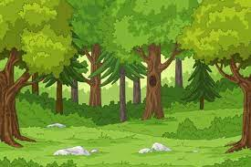


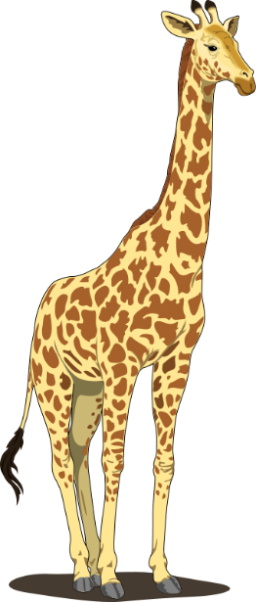
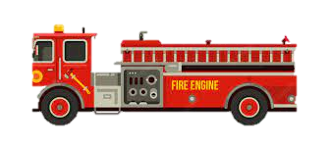

Slide 2

Introductions
Teachers
Miss Swift (Foxes) and Mrs Reeves (Squirrels)
Teaching Assistants
Mrs Bullen, Mrs Brakenridge
Mrs Chilvers and Mrs Baird

Slide 3


Topics
Autumn – Bold and Brave
Spring – Fire and Ice
Summer – Wild and Wonderful

Slide 4

Autumn
Some of the things we will be looking at…
Our school and local area
The Last Wolf
Rosie Revere Engineer
Science – habitats and materials
Geography – our local area
History – a famous person from the past (Amelia Earhart)

Slide 5
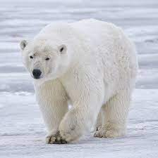
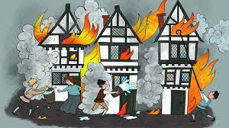
spring
Some of the things we will be looking at…
Geography – Polar Regions
Polar animals research
The Arctic Song
History – The Great Fire of London
DT – fire engines
Masha and the Firebird

Slide 6

summer
Some of the things we will be looking at…
Geography – Africa and Kenya
The Hunter
James and the Giant Peach
African animals research
Minibeast poems
DT – sewing African animals
Science – plants, animals and humans
Notes:
New RE?

Slide 7
seesaw
We will continue to use Seesaw this year. The codes are in their Home Learning books.
We will upload home learning to Seesaw on Fridays and it is due on the following Thursday.
We will send other useful information via Seesaw.
Seesaw is a useful way of contacting the teachers, but is not always checked until Home Learning is due in, so please use class emails for urgent messages etc.
foxes@holbrookprimaryschool.com
squirrels@holbrookprimaryschool.com

Slide 8
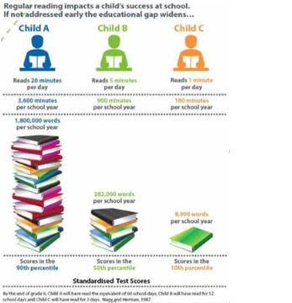
Reading
We encourage parents and children to record reading experiences regularly in their reading diaries (Home Learning policy = daily reading until colour bands are finished, then 4x a week afterwards.) We also enjoy hearing the children read at home on Seesaw.
We collect up the reading diaries on a Friday so please ensure they are in school.

Slide 9
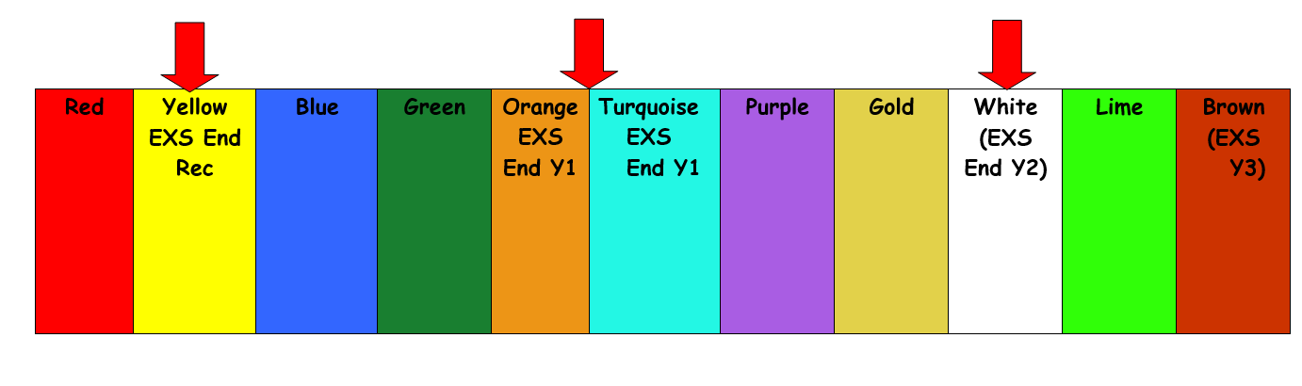
Reading
In school, children will experience reading in a variety of contexts, for example as a whole class, group or individually with a teacher/TA/parent helper.
Some children will be bringing home phonic reader books matched to the letter sounds they know, as they did in Year 1. Please ensure the children have their reading books in school every day in case we want to read with them. They may also bring home a book to share with an adult.
Phonic Reader books merge into green colour band books, and children on these levels are encouraged to take responsibility for changing their books once they have read them at home. We issue regular reminders, but the ultimate responsibility is with them.

Slide 10
A home learning task will be one of these things we have covered during the week. We will vary the task so it might be a maths focus or spelling activity for example. We are happy with anything and in fact enjoy seeing your creativity!
Reading and mental maths is an ongoing home learning task and should be done regularly.
Later this term, we will begin our Karate Spellings (these are the ’tricky word’ spellings that children are expected to know in YR, Year 1 and Year 2 as set out in the National Curriculum).
Home learning

Slide 11
Reading:
Song of Sounds tricky words
Regular reading, including reading to the children
STATS POSTER
Maths:
Counting
Number bonds to 10 and 20
Telling the time
Spelling:
Tricky words (Karate spellings) and Year 2 spelling patterns and rules
General:
Praise effort
Encourage independence and a growth mindset
How you can help

Slide 12

Extra-Curricular
Autumn term – Y1 and Y2 Nativity
Spring Term – Fire Engine visit
Summer Term – Drusillas Trip
Other things may arise during the year.

Slide 13
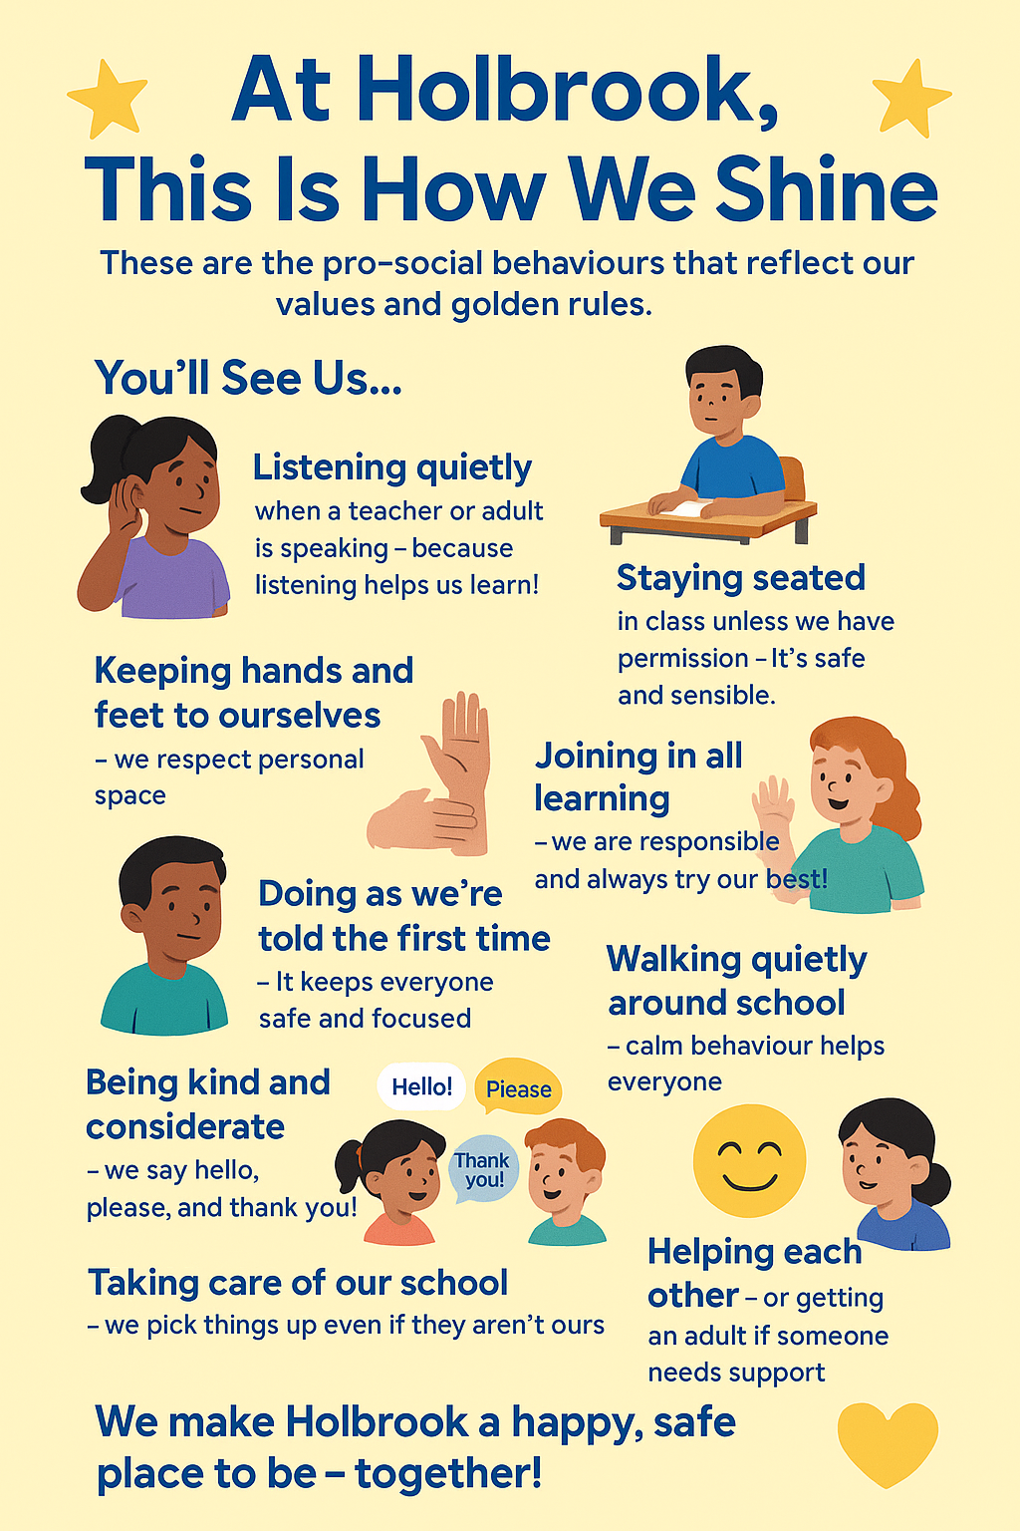
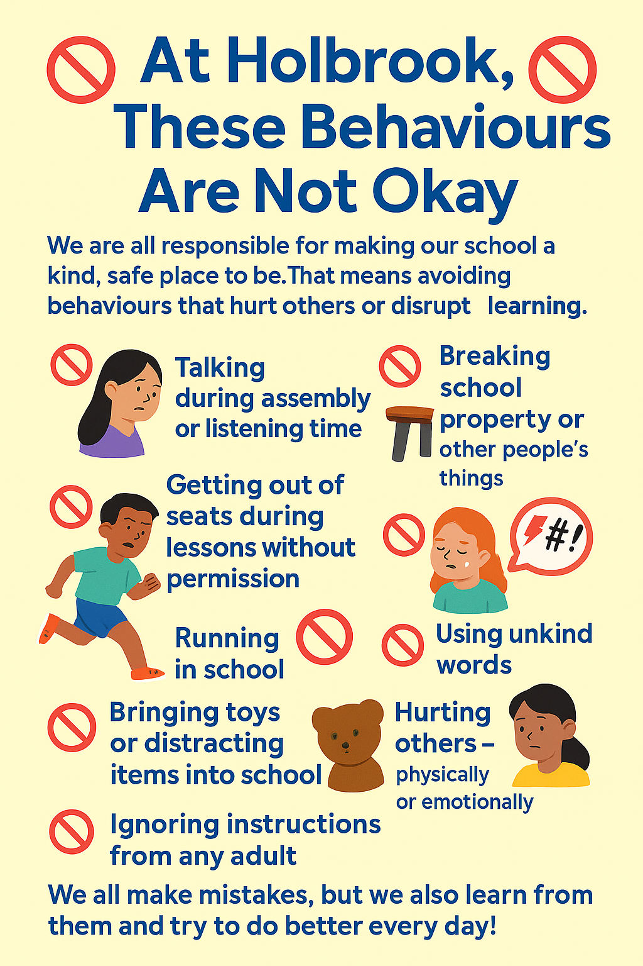
Expectations for Holbrook Children

Slide 14
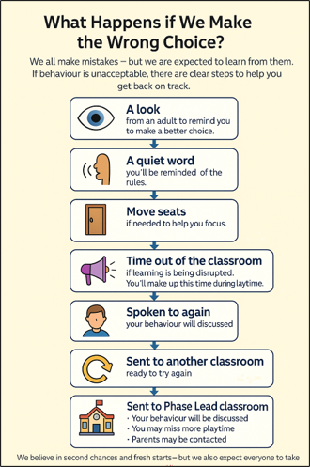

Slide 15


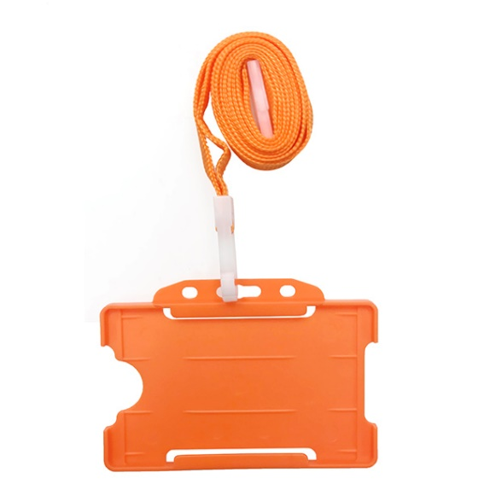
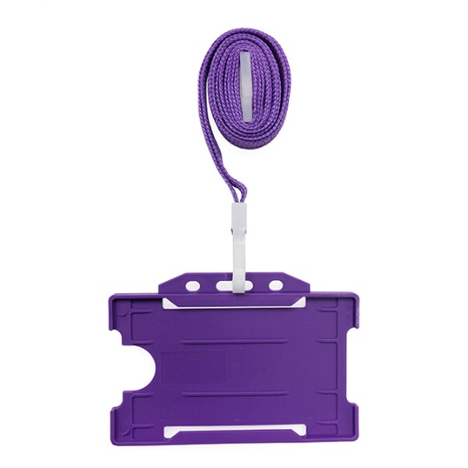
Learning Skills
Gold Award
House Points
House Star
Maths Mentor
Writing Mentor

Slide 16
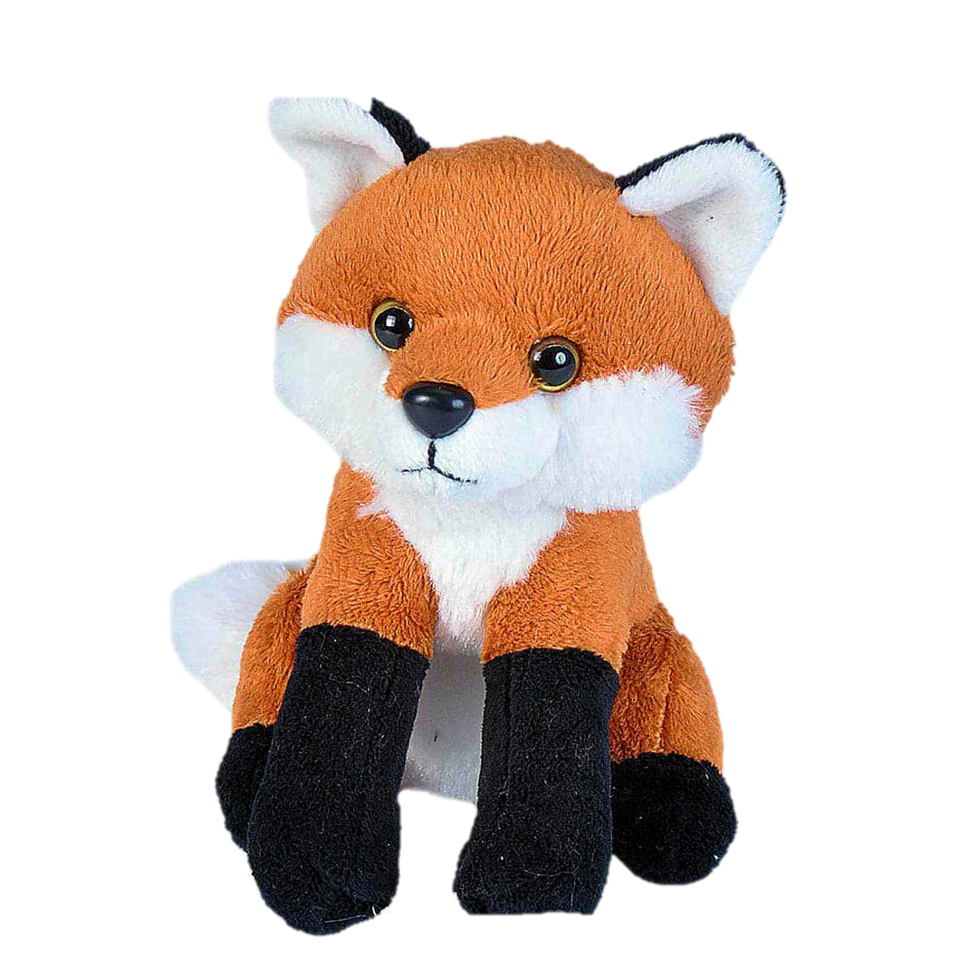
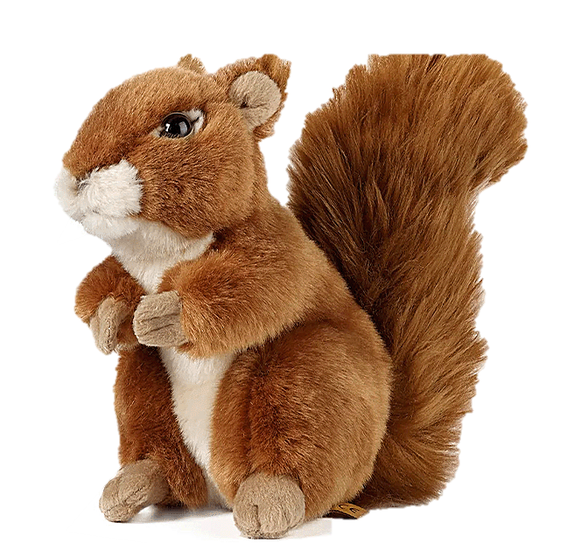
Fox and Squirrel Adventures!

Slide 17
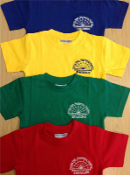

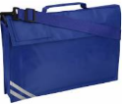

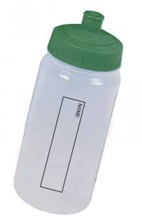
Other Information
PE – Tuesday and Wednesday
Please remember to take earrings out for PE days or cover them in tape
The children can wear their kit to school on these days. The children should wear plain black shorts/joggers and their house t-shirts. They should wear their usual royal blue Holbrook School jumper/cardigan/fleece
We go out to play and PE in all weathers so please ensure they have warm/waterproof coats for cold and wet weather and hats for hot weather
Water bottles in school
Book bags – that fits into tray
Hair tied up with school colour hair ties
Laces
Reading morning - Fridays

Slide 18
Useful contacts
Class emails:
Foxes: foxes@holbrookprimaryschool.com
Squirrels: squirrels@holbrookprimaryschool.com
X:
@PrimaryHolbrook
Facebook:
Holbrook Primary School
Website:
Holbrook Primary School

