Slide 1


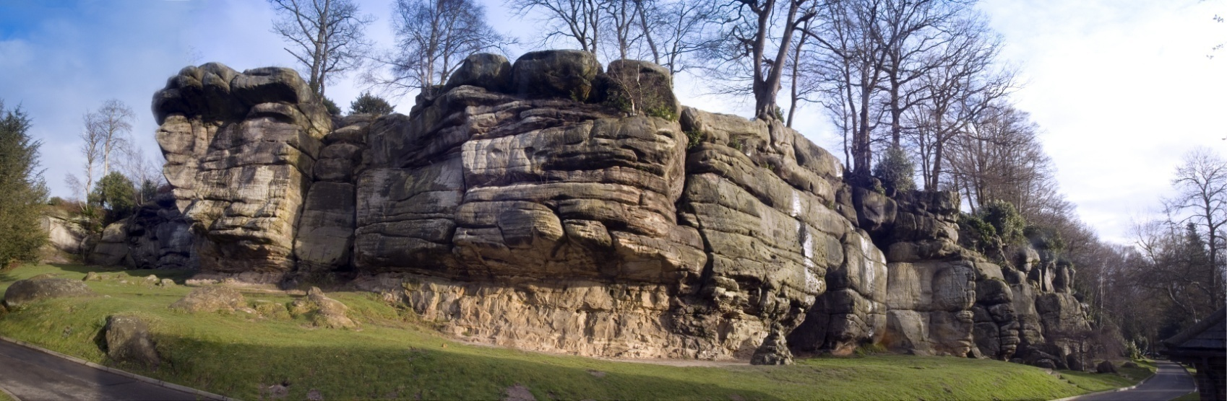

Holbrook Primary School
Year Six Outdoor Education Residential Visit
Monday 19th till Friday 23rd September 2022

Slide 2
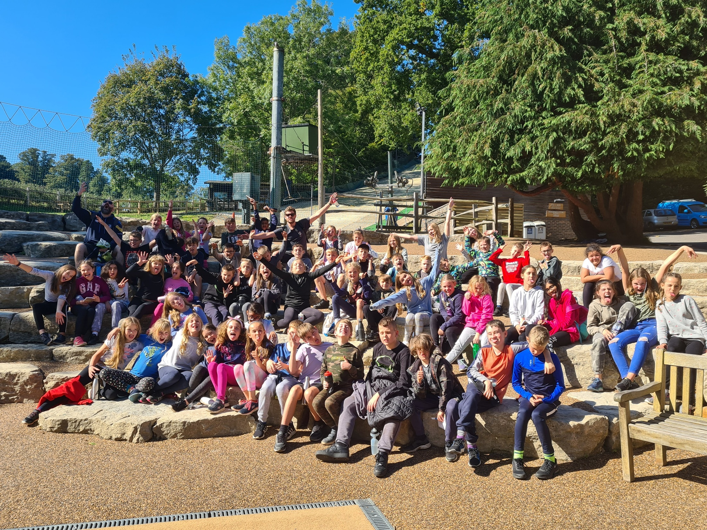
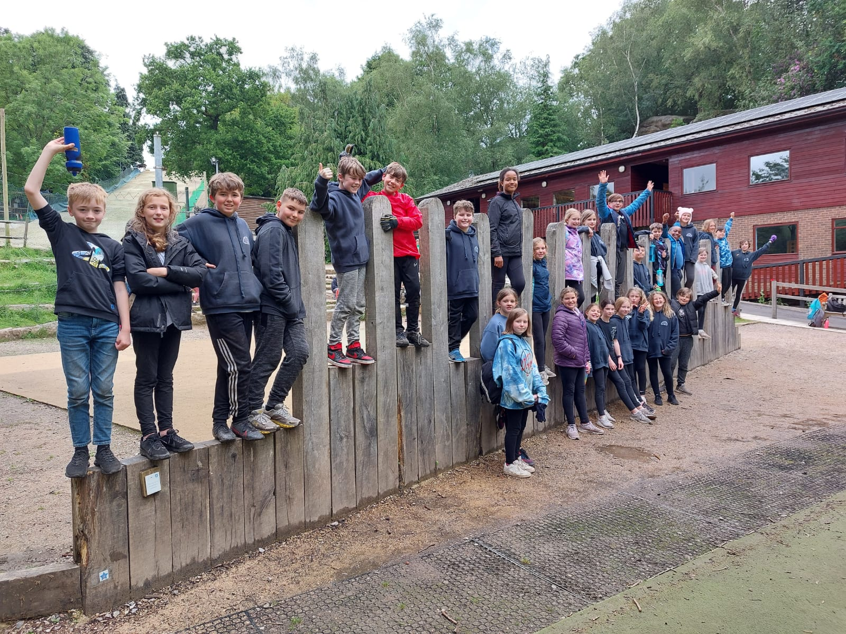
Year 6 at Bowles in 2021

Slide 3
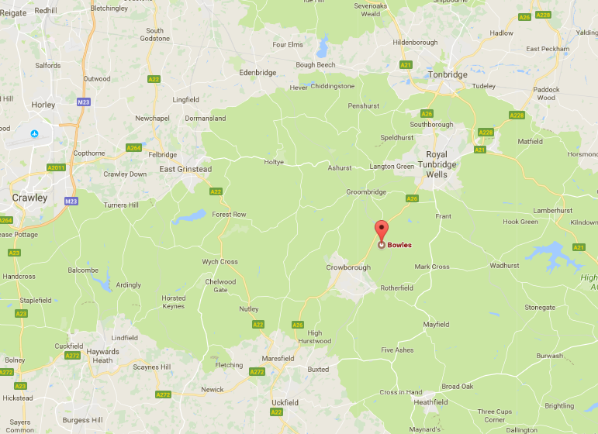
32 miles, 1 hour travelling time

Slide 4

Bowles at a glance

Slide 5
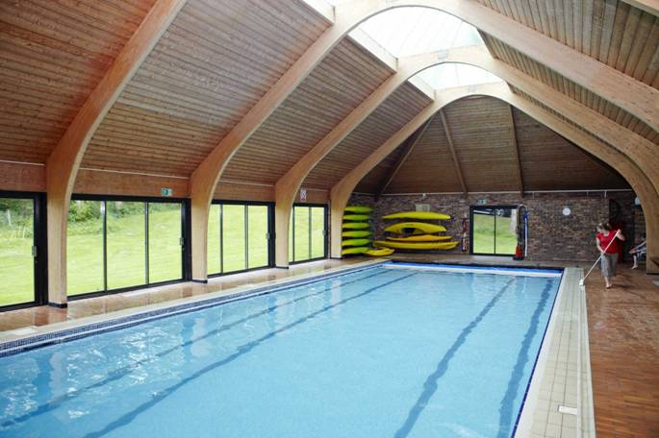
  On site at Bowles
  A centrally heated modern dormitory
  Two dry ski slopes
  Indoor heated swimming pool
  Several ropes courses
  Safety and wet weather equipment
  And its very own 130 million year old sandstone outcrop!
  Off site activities:
  Harrisons rocks
  Kayaking on the River Medway

Slide 6
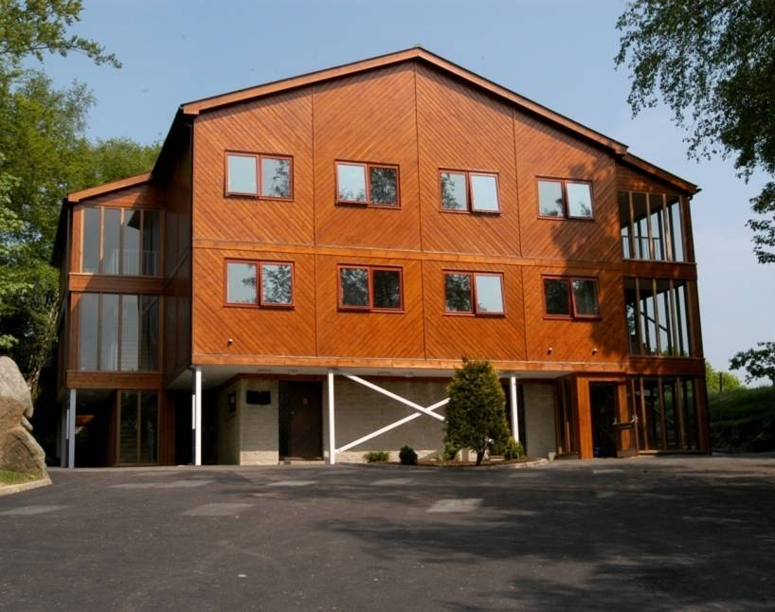
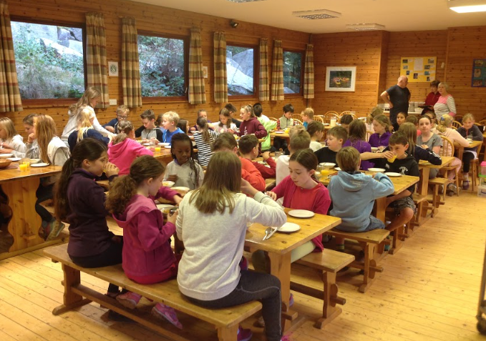
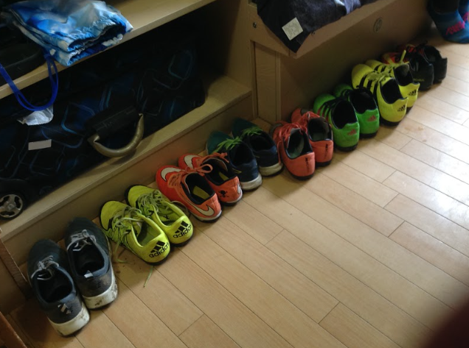
Healthy Meals
Modern Accommodation

Slide 7
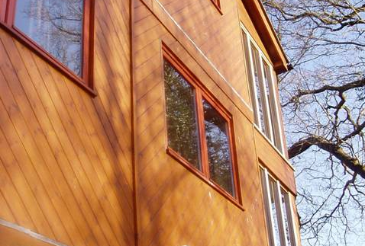
Dormitory Accommodation
  104 beds over two floors
  7 beds per room
  Separate teachers’ bedrooms and showers
  Securely locked overnight
  Possibly sharing with another school, but in a separate area.
Bowles instructors live onsite and are on call through the night

Slide 8
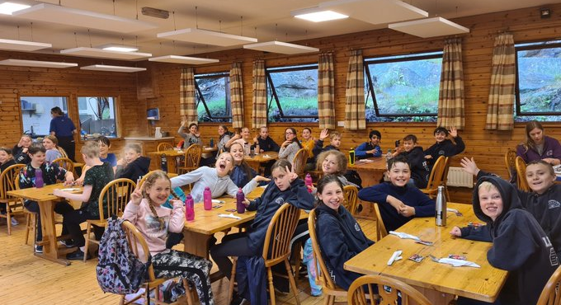
Home-Cooked Food
  Three healthy, hot, home cooked meals a day
  ‘Family service’ – children serve themselves and each other
  Vending machines and tuck shop for drinks, snacks and souvenirs (only one sweet per day as part of Bowles’ healthy eating policy.)
  Children also clear up after themselves!
Notes:
8

Slide 9
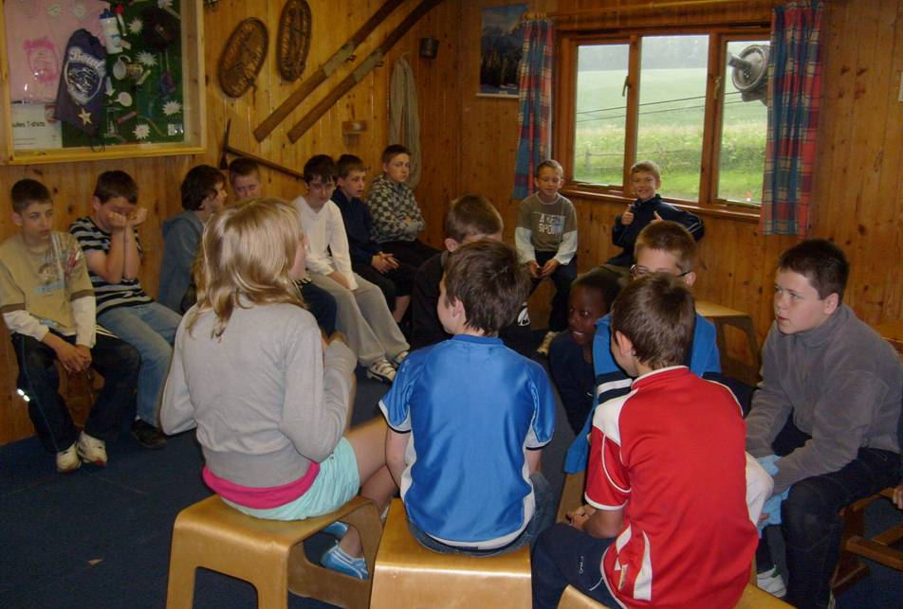
Allocated free time
  All weather games pitch
  Table Tennis
  Table Football
  Woodland activity area
  Common room with books and indoor games
  The Cabin with hot and cold drinks
Notes:
9

Slide 10
A ‘typical’ day
8.15 Duty group lay tables for breakfast
8.30 Breakfast
9.00 Prepare for the day
9.15-12.30 Activity Session
12.30 Lunch then free time
1.40-5.00 Activity Session
5.15 Bowles Diaries/ free time
6.15 Dinner then free time
7.15-9.15 Activity Session
9.45-10 .00 Bed and lights out
Morning
Afternoon
Evening

Slide 11
Run through of the day we leave
Arrive at school for 9am
Enter through the outside classroom door (leave your luggage on the playground)
Adults will be outside to collect any medicines
We are aiming to leave school at 9.45
If you are unable to get your child to school at these times please let us know!

Slide 12
Medicines
A specific Bowles medicine form needs to be completed. You can pick up one of these today.
This must be handed in to Mrs Brookes or Miss McLoughlin before we leave on the day.
Please include travel medicine for the journey home, but also for the 2 trips whilst we are there.
All medicines must be in their original packaging and the child’s name (on the bottle) with patient information leaflet.
All medicines which are currently at school will also be brought on the trip.

Slide 13
Arriving at Bowles (11:00)
What happens next:
Allocation of rooms, bed making and unpacking
Fire drill and general safety instructions
Lunch on the first day (provided by Bowles)
Activities start

Slide 14
General
Rooms
Groups
Duties
Drinks
Bedtime
Behaviour

Slide 15
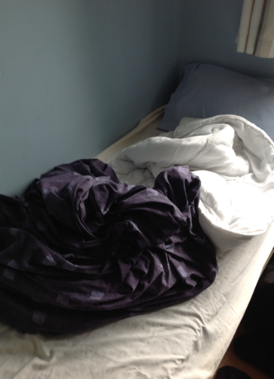
Children have to make their own beds:
Put on a fitted sheet
Put a pillow in a pillow case
Put a duvet cover onto a duvet
Some practice at home would be helpful.

Slide 16
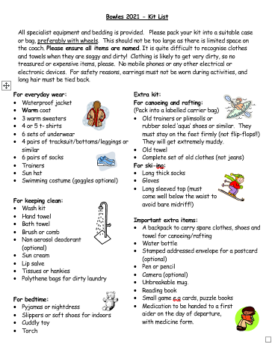
Kit list – sent out again today

Slide 17
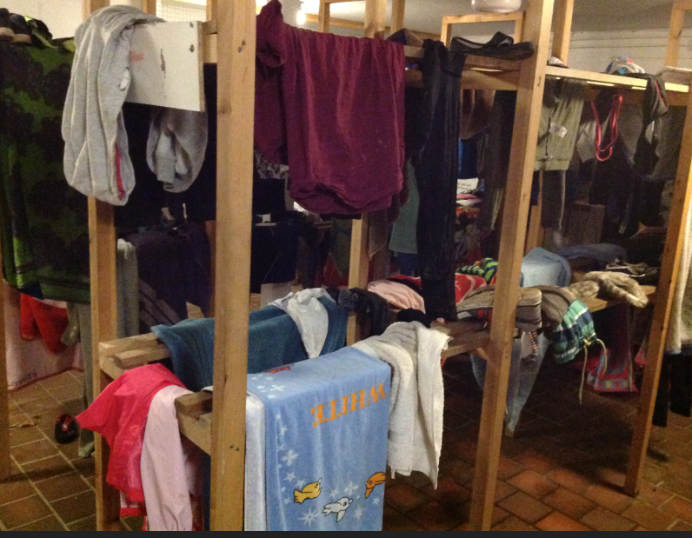
Why you need to name EVERYTHING

Slide 18
Coming home on Friday 23rd Sept
The coach will be leaving Bowles shortly after 1pm. and we hope to back at the school between 2.30 and 2.45pm. (This will depend on traffic).
Please tell a member of staff when you are ready to take your child home.
If you wish another adult to pick up your child please let us know in writing before we leave.
Should there be any change in these times, a text and Parentmail message will be sent.

Slide 19
Please tell us
Any changes to the emergency contact or dietary or medical details you have already given us
Anything at all you think it would be useful for us to know about your child, however trivial it seems.

Slide 20
General Information
Emergency Contact:
If you need to contact your child in an emergency, please phone Holbrook School between 8a.m. and 5 p.m. on 01403 272500.
Outside these hours, please phone: 07835 522271

Slide 21
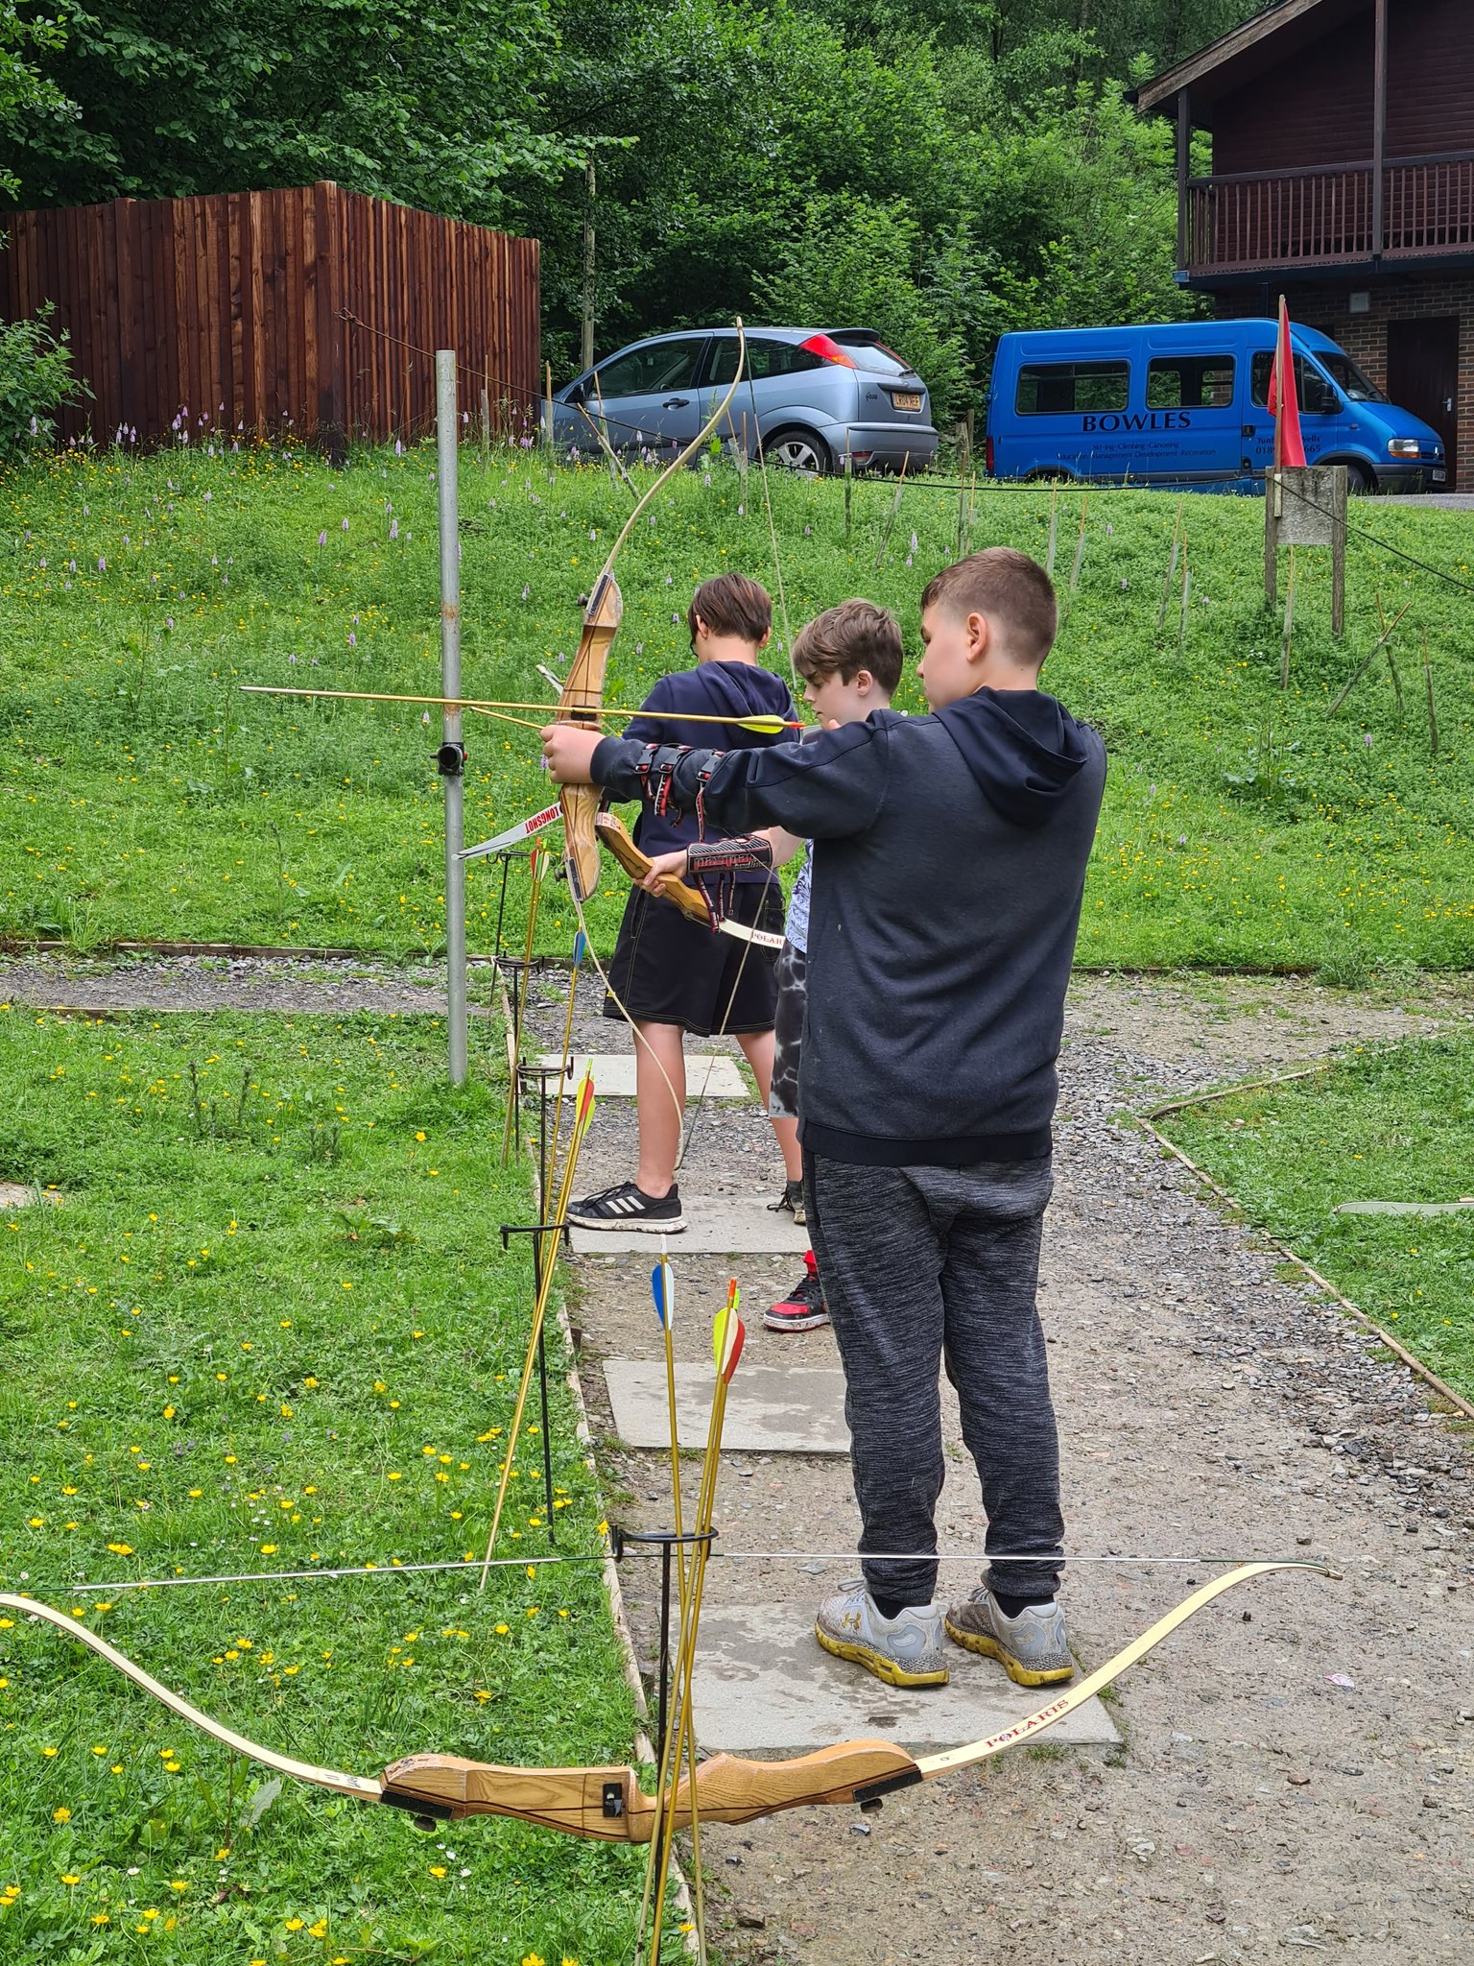
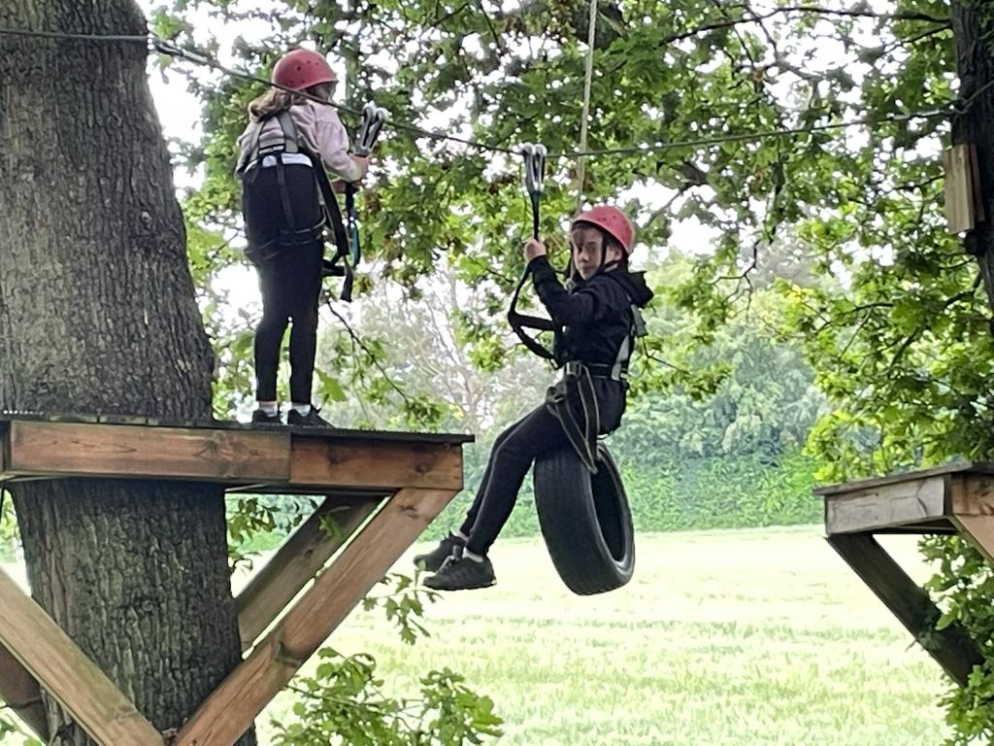
At Bowles, the children will need a Growth Mindset at times…

Slide 22
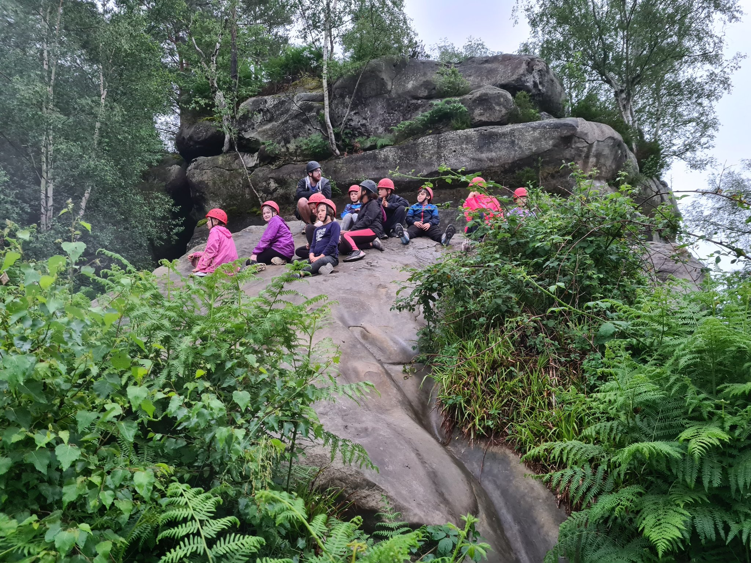
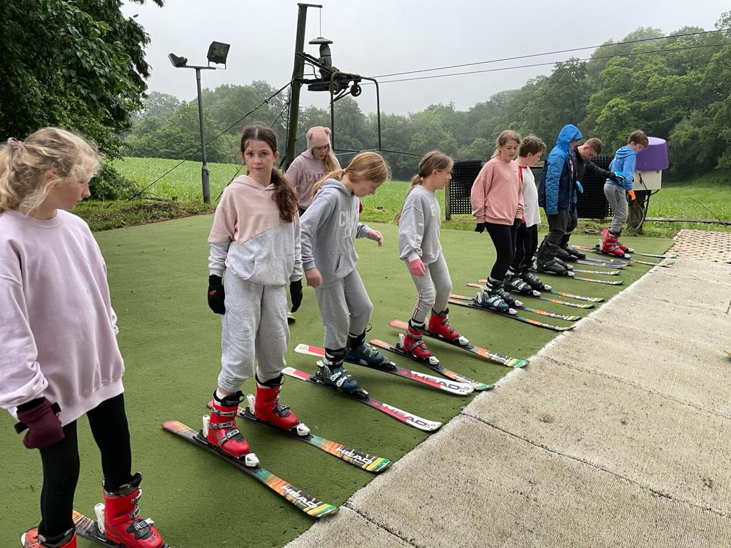
and they’ll learn a lot
about each other
and about themselves
Notes:
22

Slide 23
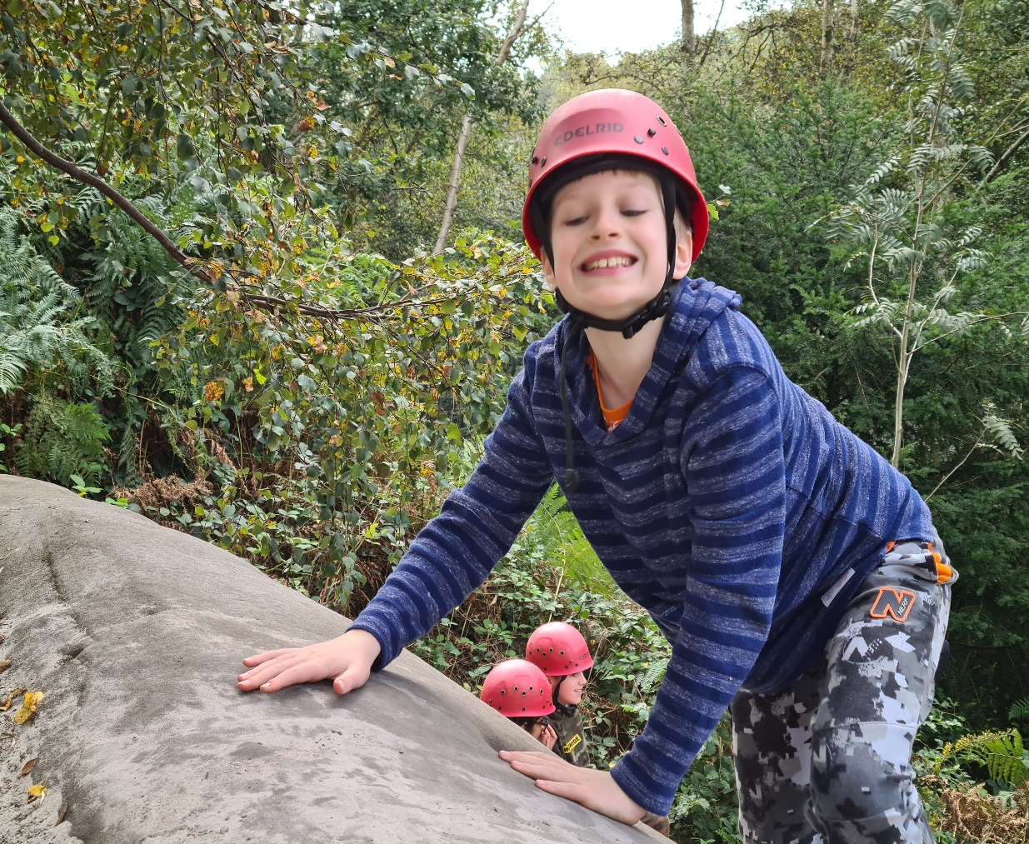
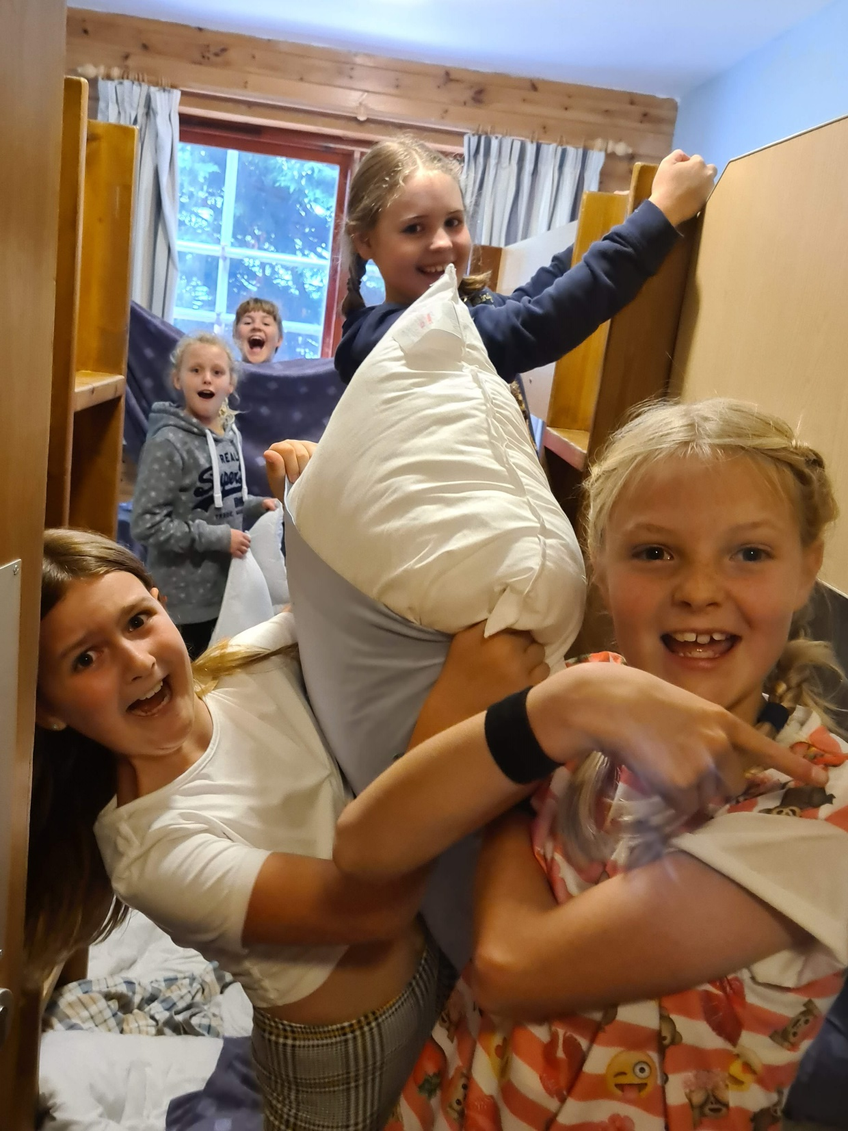
…and they are guaranteed
to have fun

Slide 24
Letter
Please ensure that you take a copy of the letter which contains all the relevant details regarding finance.
Key date: Deposit to be submitted by 31st January 2022.

Slide 25

Any Questions?

